Slide 1
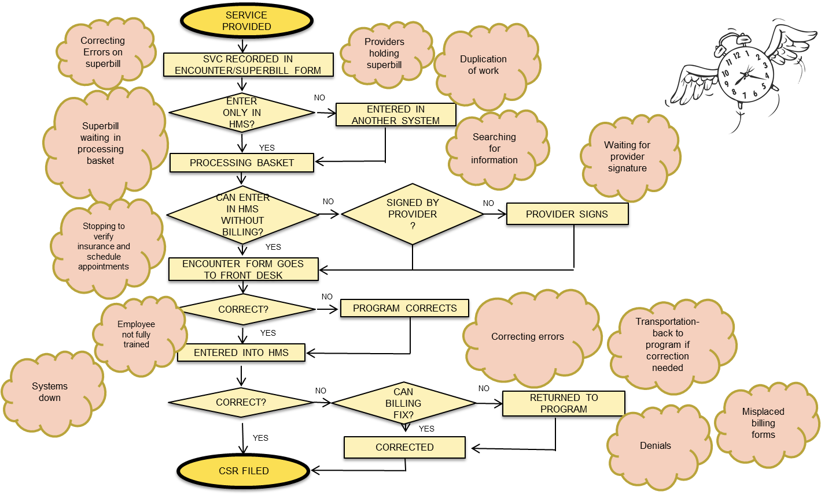
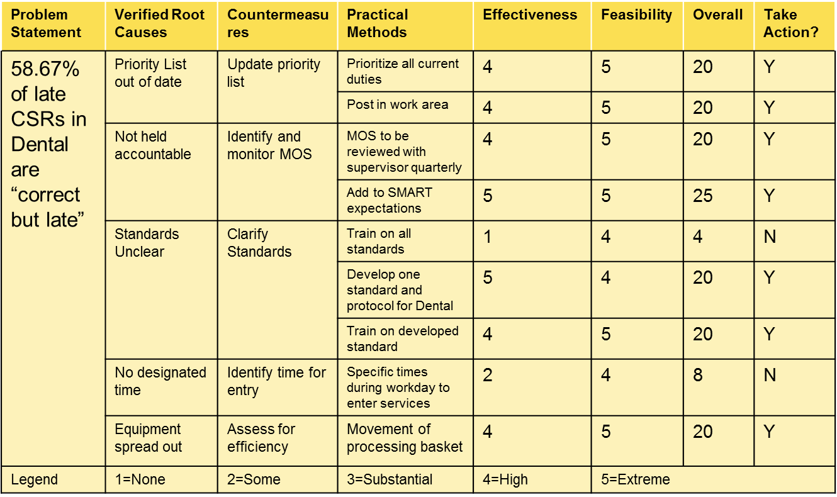
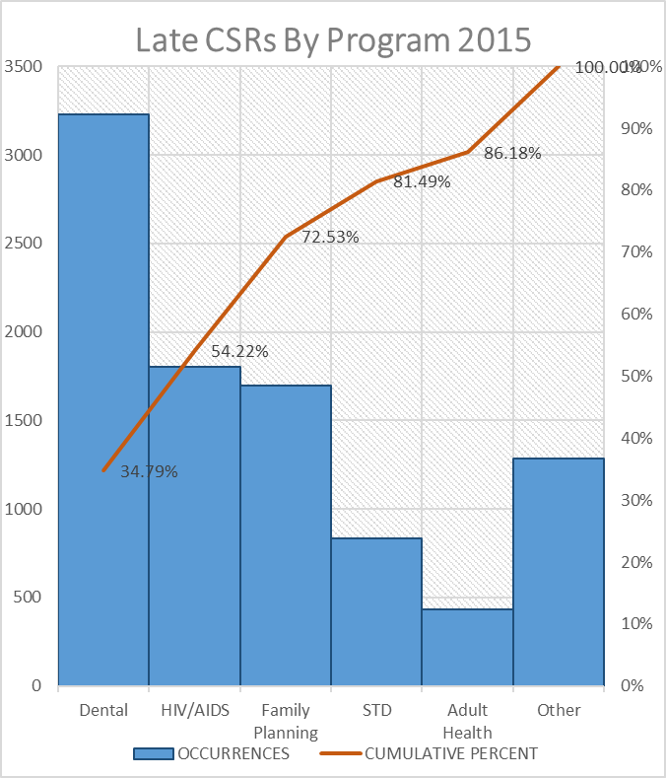
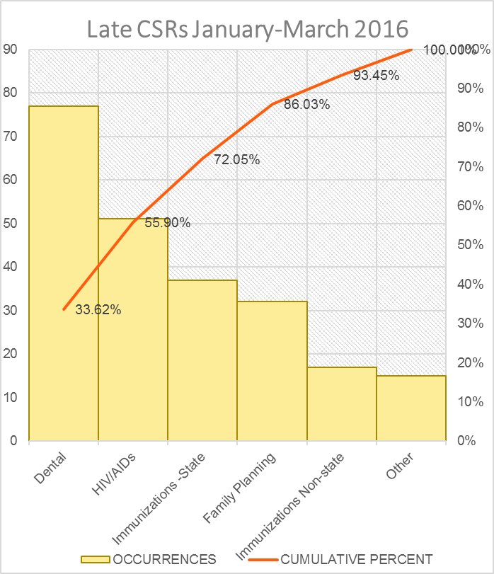
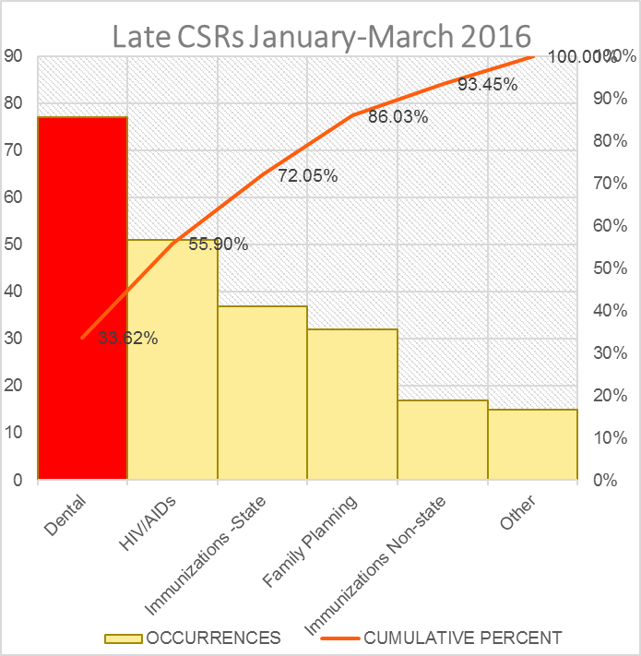
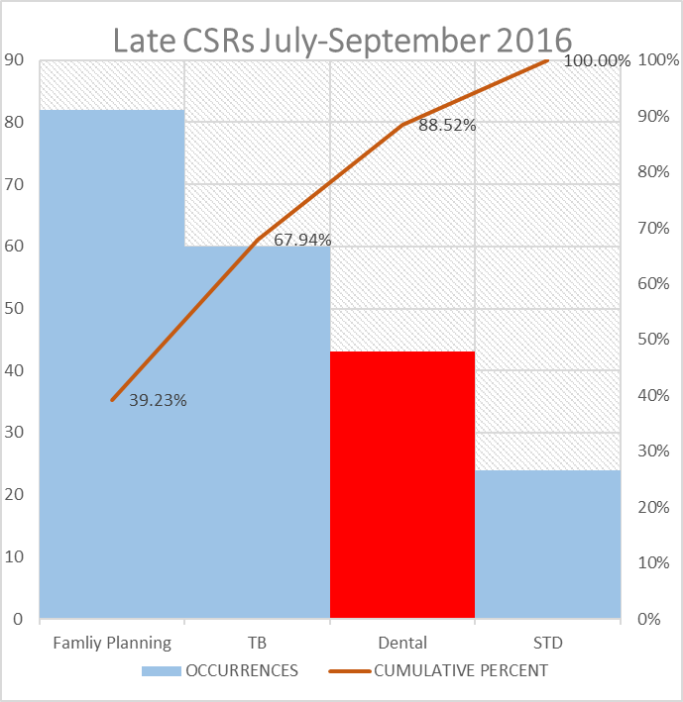
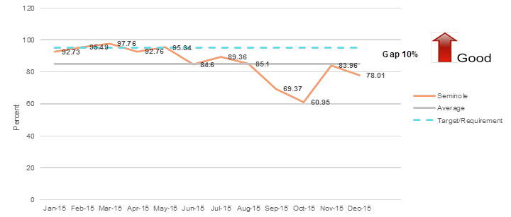
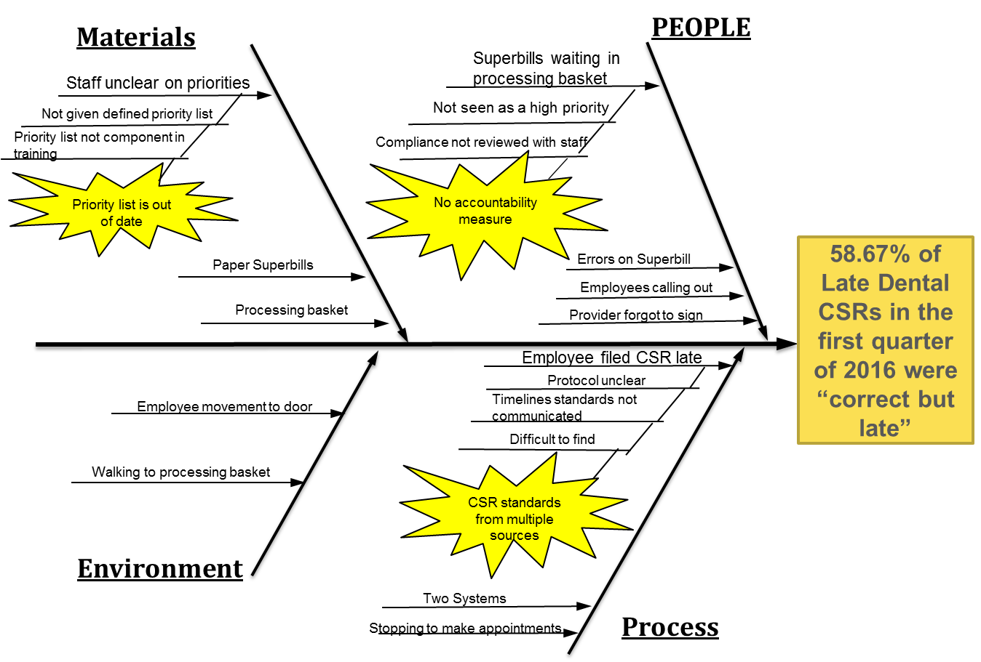
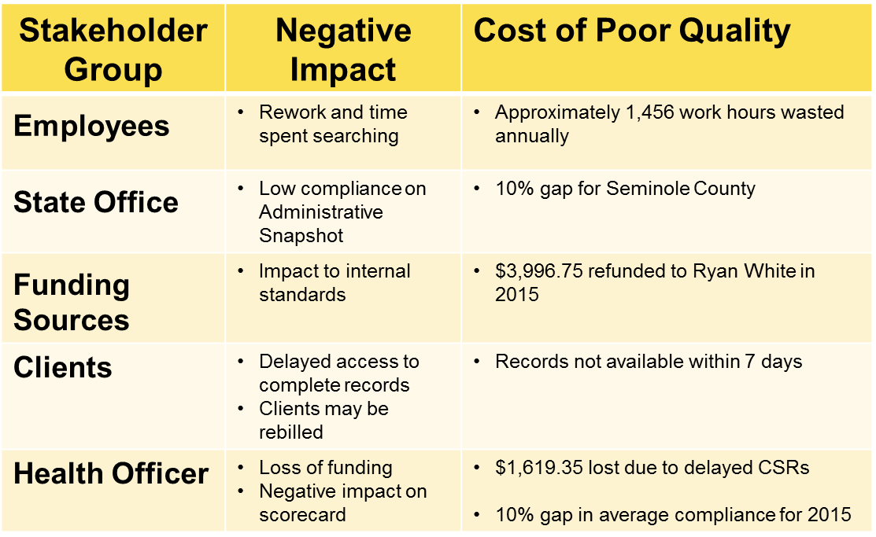
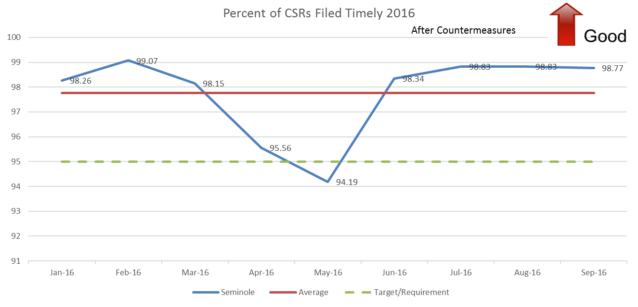
Florida Department of Health in Seminole County Quality Improvement DMAIC Project 2016: Increasing Timeliness of CSR Entries into HMS
Project Team: Crystal Wagner, Peggy Cooke, Gloria Rivadeneyra and Dhanu Mistry
Background
Measure
Improve
The Client Service Record (CSR) must be filed within 7 calendar days of providing the service to be considered timely.
In January 2016 the Executive Leadership Team (ELT) identified and prioritized projects to be completed in the 2016-2017 fiscal year. Potential projects were scored based on people, do-ability, Strategic Plan alignment, Impact on outcomes, and measurability.
Due to failure to maintain an average of at least 95% of CSRs filed timely for 2015, this project was added to the 2016-2017 Improvement Selection Matrix.
Project CSR Timeliness scored 102 out of 117 and ranked 6th on the DOH-Seminole 2016-2017 Improvement selection matrix.
A decision was made by the ELT to assemble a Green Belt Team utilizing the DMAIC approach to problem solving to result in increased timeliness of the CSR process by December 2016.
Current Process With Identified Waste
Countermeasures Matrix
A process map was developed and a brainstorming session was held to identify waste within the process.
Pareto Charts By Program
Countermeasures were developed and ranked based on effectiveness and feasibility.
Define
Before and After Pareto Charts for Late CSRs by Program
The team developed Pareto charts for 2015 and 1st quarter of 2016 to measure the number of late CSRs by program and identify the program that would make the most significant impact on the theme. The Dental program was selected for the first DMAIC cycle.
The team compared the baseline Pareto chart to the pilot data and determined that the countermeasures were effective.
Theme: To increase the average percent of CSRs filed timely from 85% in 2015 to 95% by December 2016
Analyze
Control
Line Graph 2016- After Improvements
A Fishbone Diagram was developed to identify probable and root causes for the problem statement.
The team identified five stakeholder groups and developed a cost of poor quality matrix to quantify the negative impact.
The team conducted a root cause analysis utilizing the 5 why method. Three root causes were identified.
By September 30, 2016 the average percent of CSRs filed timely for 2016 was 97.77%. The team closed out the first DMAIC cycle with plans to look into additional programs on the late CSR Pareto. The team will continue to monitor the percent of CSRs filed timely as reported on the administrative snapshot monthly. The team has future plans to develop a control chart to demonstrate stability of the process

