Slide 1
Pertussis Prevention for Pregnant Women: P³W
Protecting Infants

Slide 2
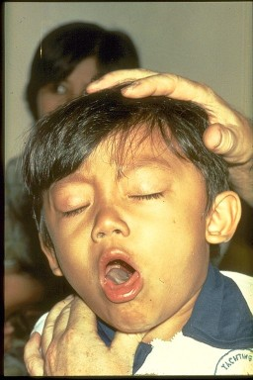
Whooping Cough US 2012
41,880 cases up from 27,550 in 2010
10.8% were infants < 1 year old
15 of 18 fatalities were children under 1 year old
Notes:
The US has experienced an upward trend in pertussis numbers for the last 15 years. Provisional 2012 data shows a significant rise.
Highest mortality impact is seen in infants.

Slide 3
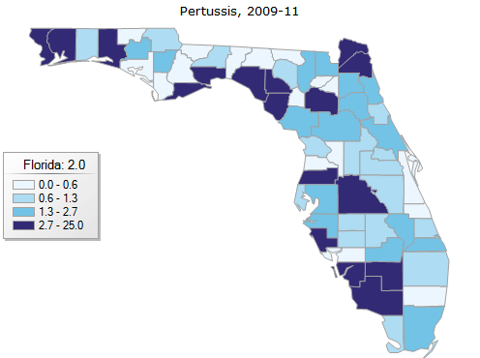
Collier County 2009-11Pertussis Burden
28 reported cases
Rolling rate 2.9 versus state rate 2.0
15th highest rate of pertussis for counties in Florida
Notes:
Provisional 2012 national rate Florida 3.1
Collier is certainly below the national average but in the top half of Florida counties.

Slide 4
Easily Prevented with Tdap Vaccine
Advisory Committee for Immunization Practice (AICP) recommends Tdap Immunization for all pregnant women after 20 weeks gestation.
Women’s Health Foundation delivers approximately 1200 or 40% of all babies in Collier County and per WHF most lack Tdap
Notes:
ACIP recommendations focus on pregnant women to help protect the most fragile (infants under 1year)

Slide 5
RWJ Grant
Partner with Women’s Health Foundation to improve the number of women who receive Tdap during pregnancy.
RWJ grant offered support for Quality Improvement functions and funded initial vaccine purchase.
GlaskoSmithKline patient assistance program will replenish vaccine for eligible clients and make our program sustainable.
Funding Source for Vaccine
Notes:
Proximity and percentage of women touched allowed for excellent partnership opportunity

Slide 6
PHAB Accreditation
Domain 4:
Engage with the community to identify and address health problems
Standard 4.1:
Engage with the Public Health System and the Community in Identifying and Addressing Health Problems Through Collaborative Processes
Measure
4.1.1 A
Establish and /or actively participate in partnerships and/or coalitions to address specific public health issues or populations.
Notes:
As the DOH and CCHD move work toward PHAB Accreditation and

Slide 7
PHAB Accreditation
Domain 9:
Evaluate and continuously improve health department processes, programs, and interventions
Standard 9.1:
Use a Performance Management System to Monitor Achievement of Organizational Objectives
Measure
9.1.1 A
Engage staff at all organizational levels in establishing or updating a performance management system.

Slide 8
Quality Improvement Tools
Cross Functional Process Map of anticipated referral process and subsequent revision
Brainstorming of potential barriers and solutions to scheduling
Data collection following the initiation of referral process
Root cause analysis and Rapid Cycle Intervention

Slide 9
Identify Public Health Problem
June 2012 Discussions with WHF regarding need for Tdap vaccine for pregnant women as recommended by ACIP
Problem
Iden. Currently no women receiving vaccines
WHF unable to provide vaccines
July 2012 Identified GSK vaccine patient assistance program
Grant availability identified
Research
August 2012 Application prepared for COPPHI grant
Adult Immunization Policy updated to include Tdap recommendations in pregnant women
October 2012 ACIP recommends Tdap with each pregnancy

Slide 10
Plan
November 2012 Notice of grant award
Registered with GSK VPAP
Plan
Meetings with WHF – Physician Assistant, clinic coordinator and RN coordinator to discuss potential for data sharing
Training and brainstorming with WHF staff Application and financial documentation requirements for GSK eligibility Potential barriers
WHF printed prescription for “TDaP client > 20 weeks gestation”
Process Flow Chart of anticipated process

Slide 11
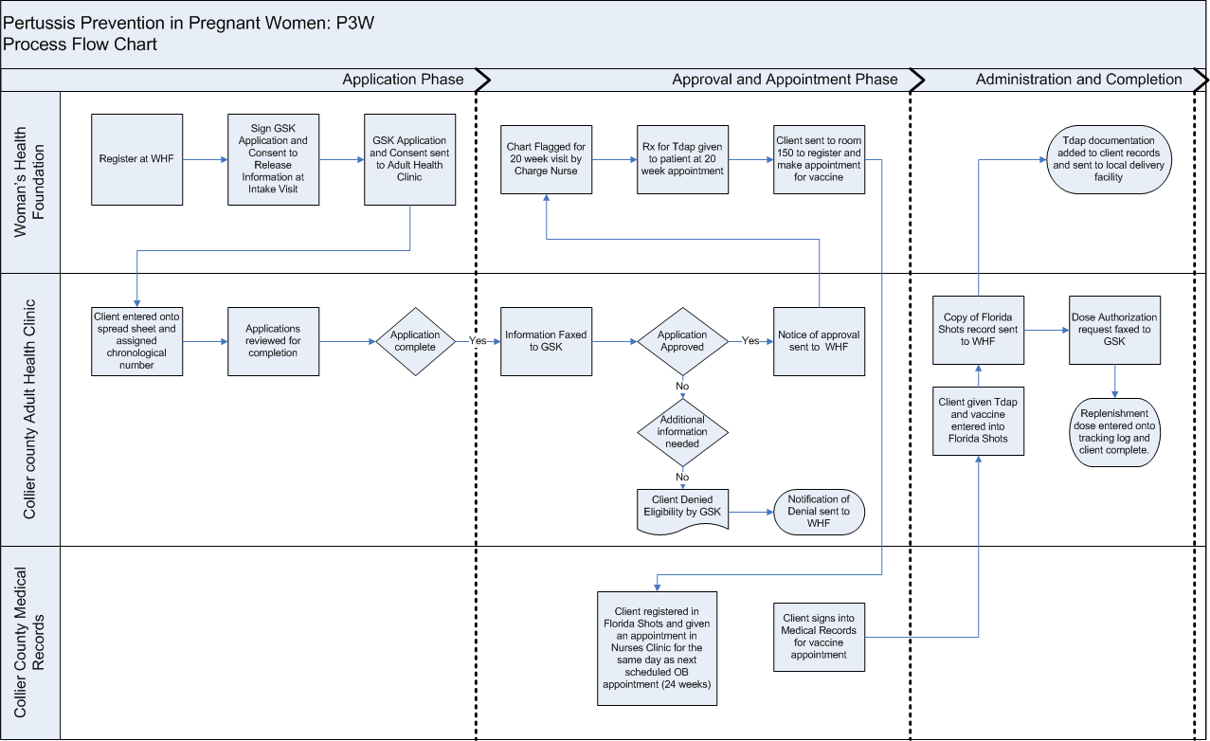
Process Flow Chart

Slide 12
Do and Check
December 2012 WHF began completion of applications
Do Coordinator attendance at the Open Forum Meeting for Quality Improvement in Public Health – Charlotte North Carolina
Jan/Feb 2013 84 applications received 52% needed additional Study information
RCI Collaboration with clinic coordinator fixed problem
March 2013 Identified women were not making appointments for
vaccine.
RCI
Trialed walk-in process so women could obtain vaccine while waiting for their OB appointment

Slide 13
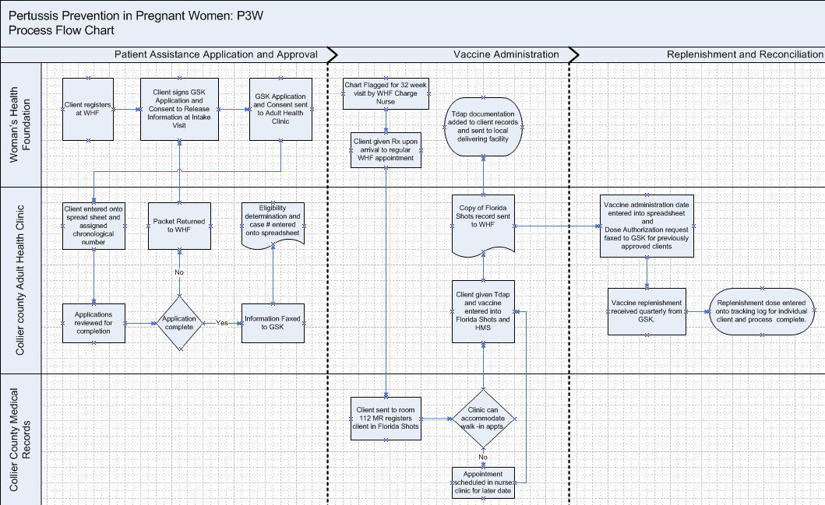
Revised Process Flow Map

Slide 14
Act
April 2013 Presented program at Collier County Immunization Coalition meeting
ACT Presented program at the Strengthening the Community of Practice for Public Health Improvement (COPPHI) Cycle 2 Webinar Series
Evaluated approval rates and impact of vaccinating women who did not qualify for the GSK program and offered free vaccine to all pregnant women (we will bill clients who have insurance).
June 2013 Will develop a system to send women <26 who do not qualify for GSK program for Tdap under Program 17 in order to sustain program

Slide 15
Accomplishments to Date
458 women touched
251 or 51% approved
117 or 25% denied
172 vaccines administered
Initial process revised to meet customer needs
92 clients vaccinated who did not have VPAP application
Only one client declined!!!
Funding to cover all women in 13-14

Slide 16
Next Steps for QI
Monitor and track how many woman with applications never obtain vaccine.
Monitor percentage of women are receiving vaccine at optimum 27-32 of pregnancy
Work with hospitals to determine overall Tdap coverage at delivery

Slide 17
Expand your horizons……….
Vaccine sent to Immokalee site to use with adult health clients and target fathers of clients seen at OB clinic
Begin to utilize vaccine assistance program for HIV and adult health clients
Work with child health on joint project to immunize fathers, grandparents and caretakers of newborns
Coordinate with private physician offices to assure Tdap for women seen at private OB providers

Slide 18
The Goal
WHOOP
Prevent Pertussis

