Slide 1
Open Access Scheduling Quality Improvement Project Kaizen Event
18-21 January, 2011 Macon County Public Health Franklin, North Carolina

Slide 2
Open Access Project Team Membership
Dr. Jimmy Villiard, DVM, Personal Health Section Administrator- Leadership Representative
Missy Boston, RN, Nursing Supervisor
Stan Polanski, PA
Leigh Tabor, Laboratory Technician
Kathy McGaha, Healthy Carolinians
Diane Keener, Management Support

Slide 3
Open Access Kaizen Participants
Project Team
Ms Susannah Poteat-Godwin, NCSU, Lean Healthcare
Jim Bruckner, Health Director
Tammy Keezer, Operations Section Administrator
Angela Rufner, Clerical Supervisor
Debbie Reeves, Laboratory Supervisor
Desiree Trudeau, WIC Supervisor
Maggie Vendrell, Interpreter

Slide 4
Prior to Open Access
“Silo Clinics”- clinics scheduled by type of appointment ex. family planning, prenatal, BCCCP, child health
Laboratory patients would schedule appointments to be seen
WIC patients sometimes placed on lab schedule- hit or miss
All lab patients would check in with clerical
Clerical staff aligned with programs

Slide 5
Problems
Unfilled clinic appointments
High clinical staff downtime
High “No-Show” rate for some clinics
Long wait time to get an appointment for family planning
Lack of coordination between WIC and clinical programs
Silo mentality (Territorialism) among staff

Slide 6
Patient Calls for Appointment
BCCCP/WW
(2 X Month)
2-3 Week Wait
Lab
(Seen within 72 Hours)
Child Heath
(2 X Month)
2-3 Week Wait
Receptionist Answers Call
Nurse
(Seen within 24 Hours)
Family Planning
(5 X Month)
2-3 Week Wait
Receptionist- Reason for Visit
PE’s
(2 X Month)
1 Month Wait
Receptionist- Look at Clinic Schedule
Prenatal Clinic
(1 X Week)
1 Week Wait
Clinic
Receptionist- Available Appointment and Schedules

Slide 7
Open Access Project
Goals
Improve Access to Care
Reduce appointment wait time to less than 72 hours
Increase number of Same Day Appointments
Reduce Staff Down Time
Reduce unfilled appointment slots
Reduce number of No-Shows
Increase Customer Satisfaction
Reduce wait time to get an appointment
Improve clinic flow

Slide 8
Aim Statement
“We aim to reduce the time it takes for a patient to make a clinic appointment to when they are seen to less than 72 hours, reduce our ‘No Show’ by 50 percent, and increase our number of clinic visits a month by 10 percent by 1 April 2011. We aim to make these improvements while also improving patient satisfaction and staff job satisfaction. We will measure our progress by tracking the following 3 metrics: 1, time from when patient calls to scheduled appointment; weekly ‘no-show’ rate, and number of appointments available and number unfilled. We will accomplish our goal by tailoring a system to our community’s needs and health department assets by visiting health departments that have transformed to an open access system, working with state consultants, updating scheduling system to allow scheduling flexibility, and staff education and training. ”

Slide 9
Clerical Post Kaizen Changes
Implement Demographic form
Last, first, middle name
Recent name changes
Data collection
Call volume
Call back (No we can’t give appt- multiple attempts for appt)
No shows/available slots (HIS report)
Patient satisfaction

Slide 10
Clerical Post Kaizen Changes
Staff training
HIS
Phone system
New process change w/lab and clinic
Cheat sheet for times allocated for appt time
Nurse and Interpreter assisting with making appointments 8-830 M-F
Medical Records Clerk (MRC) assistance M,W,T,F 8-12
Pull charts for lab
File and Pull Charts

Slide 11
Scheduling Template

Slide 12
Laboratory Post Kaizen Changes
Schedule is worthless- Transition to Walk-In Lab
Drug test still schedule by lab directly
Paternity test still schedule by lab directly
Community Care Clinic on Tuesdays and Thursdays 10-11:30
Notified CCC
Outside Doctor Orders- MWTF- 8-10
Notify doctor’s office about change in process
Communication meeting- get on agenda
Phone script for clerical staff
Phone message script

Slide 13
Laboratory Post Kaizen Changes
3 staff on Tuesdays and Thursday
Regular Doctor Orders Patient (Frequent Flyers) sent direct to lab without checking in with clerical
Charts pulled by MRC
Laboratory identified as next QI project

Slide 14
Laboratory PDSA

Slide 15
Nursing Post Kaizen Changes
Program manager does post counseling/final step for BCCCP patients when ever available
Nurse shadows patient from beginning to end- especially for FP patients
Nurse assist provider in Exam Room, except for Pre-Natal
Routing Slips completed before patient arrives (pre-made slips or templates)
Inform outside providers and patients of flow changes
Not sending charts to lab- can use blue lab form instead of general lab form.

Slide 16
Nursing PDSA

Slide 18
Patient Calls for Appointment
BCCCP/WW
Within 72 hours
Lab
Walk-In
Clerks, Interpreter or Nurse schedule appointment
within 72 hours or take patients name if no appointment available. If patient calls twice without being able to make appointment, clerks will make appointment and call patient back with appointment.
Child Heath
Within 72 hours
Nurse
(Seen within 24 Hours)
Family Planning
Within 72 hours
PE’s
Within 72 hours
Prenatal Clinic
(1 X Week)
1 Week Wait
Clinic

Slide 19
Weekly Template

Slide 20
Kaizen Event

Slide 21
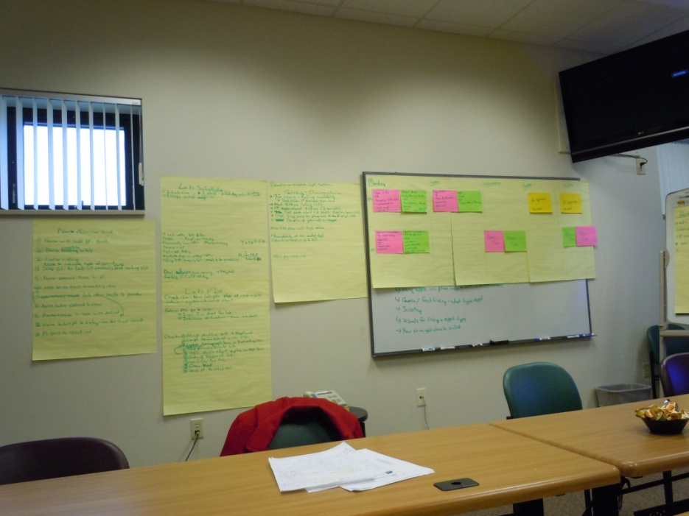
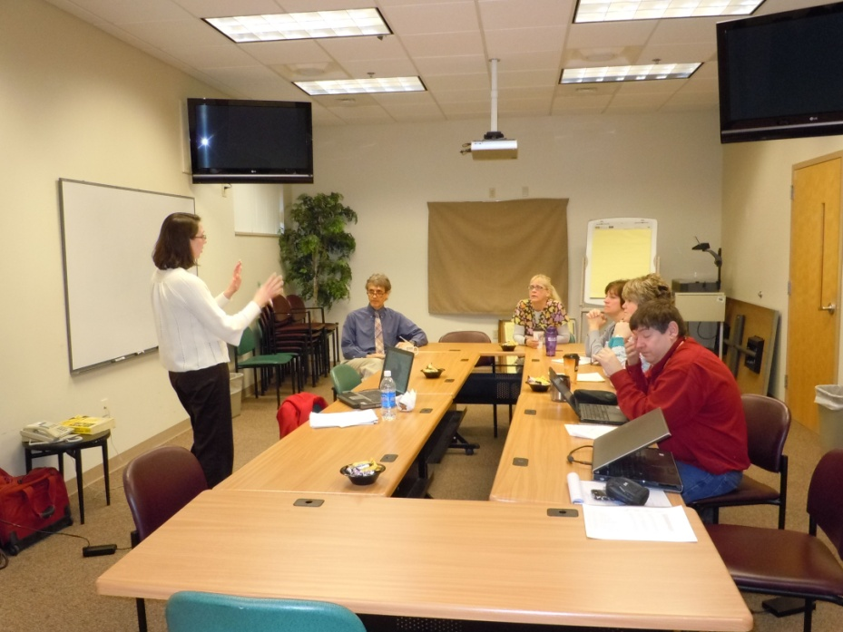
Kaizen Event

Slide 22
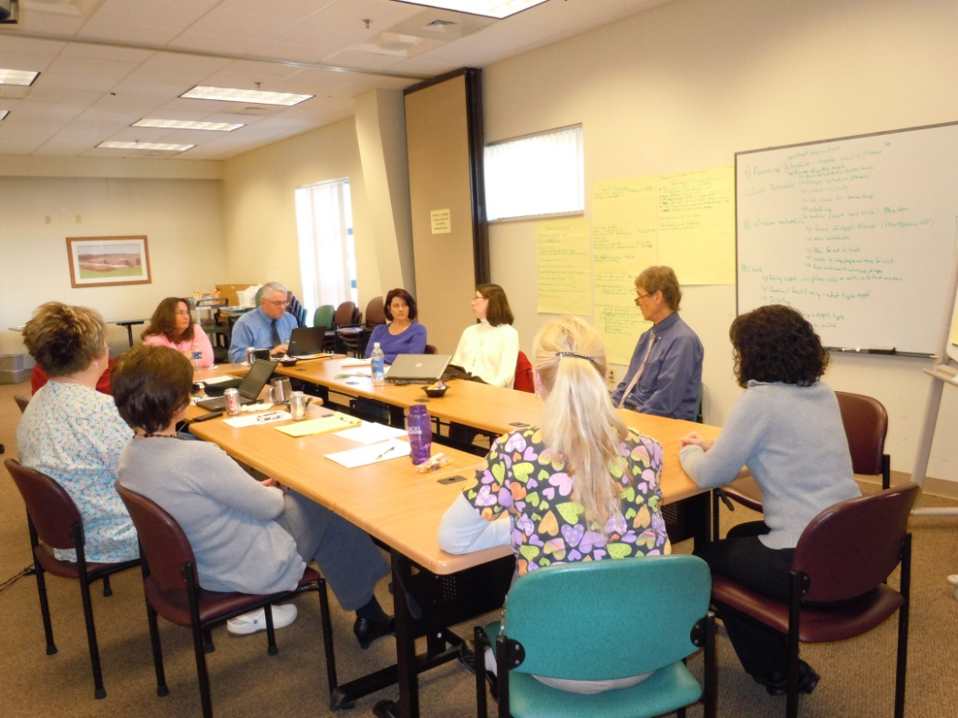
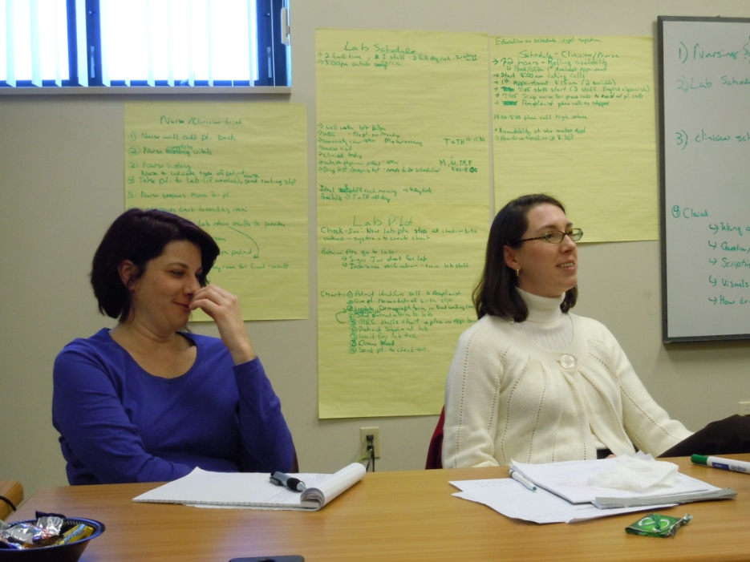
Kaizen Event

Slide 23
Post-Post Kaizen Changes
Daily meeting to discuss what went well and what went wrong with nursing supervisor, clerical supervisor, lab supervisor, PA, PHSA
Weekly meeting on Friday with all staff to discuss how the week went- good and bad
Open Access Scheduling started on February 14 with no advertising- Lets work the bugs out of the system
Grand Opening or Announcement in conjunction with Client Appreciation Day scheduled for late April
Communication Committee looking at outreach strategies- radio, flyers, business cards, press release etc
WIC realigning appointment schedule to match Agency administrative time (match laboratory)

Slide 24
Remaining Concerns
Phone message changed but phone system needs to be reprogrammed. Waiting for bugs to be worked out before reprogramming due to costs.
Clerical and HIS scheduling battles. Getting better but system still a challenge.
Finding the right balance of time per patient type.
Tendency to revert back toward old ways when thing do not go right the first time.

Slide 25
Misc. Positive Comments Heard Since Start
We are busier. Staff
Never knew we had so many people waiting for family planning annuals. Staff
What do you mean I can come in today? Client
You know, it has not been that bad. Staff
Thanks, this the best service I have ever gotten. Client
We should have started this years ago. Staff

Slide 26
Open Access Scheduling “Doing today’s work today!” …….or within 72 hours
“Quality Improvement is an ongoing process. We will make mistakes, and it is okay as long as we learn from them. We will be tweaking the system for the next 6 months till we are happy with it, then we will be tweaking it again to make it better.”
Open Access Project Committee

Slide 27
The Rest of Story
Open Access Grand Opening on April 26th to coincide with Macon County Public Health Community Appreciation Day (Public Health Month)
Highlighted Open Access on weekly local talk radio show (early April)
Developed Open Access business cards to give to patients highlighting services available

