Slide 1
The Florida Department of Health in Seminole County
Lean Six Sigma
Green Belt Project Objective:
To Reduce Client Cycle Time Within the Clinic
Team: Right on Time!
Updated April 14, 2015

Slide 2



Team Profile
Sponsor: Sarah Wright, MPH, BSN, RN
Sara Warren MPA (lead) Operations Manager
Bertie Barber BSN, RN Community Health Planning Manager
Patrice Boon RN TB-Refugee Health-Immunizations Manager
Dr. Swannie Jett, DrPH, MSc Health Officer
Yellow Belt Certified 100+ Yrs. Clinical Experience
QI Council Chair/Members Multi-Department Team

Slide 3
Operational Definitions
Cycle Time - Total time from client electronic check-in by staff to client check-out from clinic by staff.
Integrated Clinic – Clinic which provides medical services for multiple programs: Prenatal, STD, Family Planning, Child/Adult Health
Payer - The person or organization responsible for service cost.
Provider – Medical Doctor or Advanced Registered Nurse Practitioner
Short Visit - Visits identified as quick in nature (not requiring clothing removal for exam): Family Planning supply refills, Consultations, School Physicals, Pregnancy Testing, Established Client Prenatal Visit and STD Screening/treatment visits.
State Benchmark - Desired cycle time established by Practice Management Institute.
STD - Sexually Transmitted Disease

Slide 4
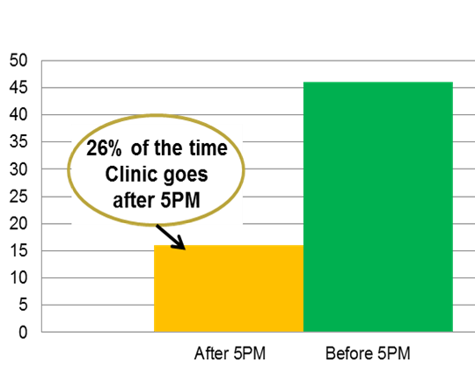
Background
Fiscal year 2014-2015 Health Officer Dr. Swannie Jett requested that the QI Council review the clinical process.
This objective was driven by internal/external customer complaints.
1.
Clinic End Times July - Sept 2014
Integrated Clinic
60 Appointments
Who:
Sara Warren
When:
10/1/14
How:
HMS/EARS
1.5 Providers / 2 Nurses
1 HST / 1 Support
AVERAGE “SHORT VISIT” CYCLE TIME (all programs) SEP-OCT 2014 = 67 MIN
Analyze
Define
Measure
Improve
Control

Slide 5
Project Selection Matrix
The team evaluated the components of the clinical process flow for stakeholder impact and need for improvement.
Potential Themes | Importance | Need to Improve | Total Score
Billing Cycle Time | 3 | 2 | 6
Client Cycle Time | 4 | 5 | 20
Eligibility Screening Cycle Time | 4 | 2 | 8
Quick Access to New Patient Appt. | 5 | 2 | 10
Scale: 1 = Negligible 2 = Somewhat 3 = Moderate 4 = Very 5 = Extreme
20
The team selected Client Cycle Time due to its impact on the stakeholder groups and identified need for improvement.

Slide 6
Selected Project Stakeholder Impact
Three stakeholder groups were identified with distinct and overlapping expectations
Stakeholder Group | Expectations
Client | -Clinical needs are met quickly and accurately
Clinical Staff | -Appointment schedule accurately reflects daily client flow -Staff will get out on time -Back-up staff will be available when assist is needed
Senior Management | -No customer complaints -Clients will leave the building on time to maintain security -Clearly defined clinical processes / cross trained staff -Meet state QI requirements and encourage QI culture

Slide 7
COST OF POOR QUALITY
Stakeholder Group | Cost of Poor Quality
Client | Decreased access to care, low client return rate, increased client frustration
Clinical Staff | Nurses working an average of 1.5 hours past normal business hours per week resulting in an estimated 235 hours requiring flex. A estimated $5,000 yearly impact.
Senior Management | Customer complaints Decreased revenue Low client return rates Poor community image Employee complaints

Slide 8
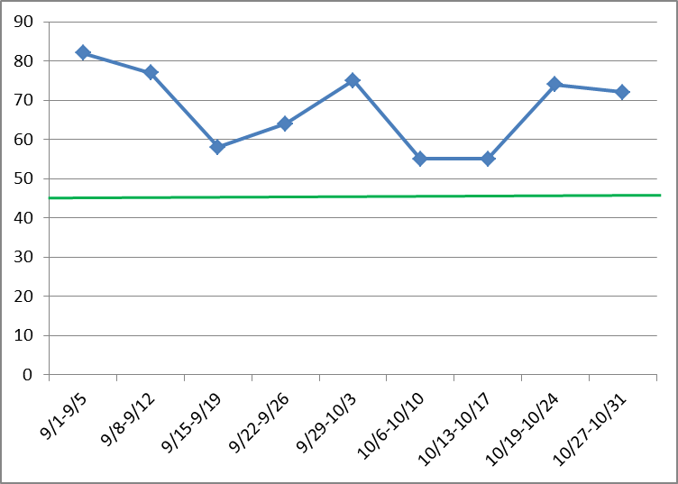



Client Short Visit Cycle Times September – October 2014
Good
Minutes
Who: Sara Warren
When: 10/27/14
How: Sign-In Sheet HMS Check-Out Report
Actual Performance
Target
3.
Theme: Reduce client cycle time through clinic for short visits to
the State Benchmark of 45 minutes by March 2015
5.

Slide 9
Project Planning
Theme: Reduce client cycle time through clinic for short visits to the State benchmark of 45 minutes by March 2015.
Duration: September 2014 – May 2015 (9 months)
PROJECT STEPS | 2014 |  |  |  | 2015
 | S | O | N | D | J | F | M | A | M
DEFINE
MEASURE
ANALYZE
IMPROVE
CONTROL
4.
Projected
Actual
Define
Measure

Slide 10
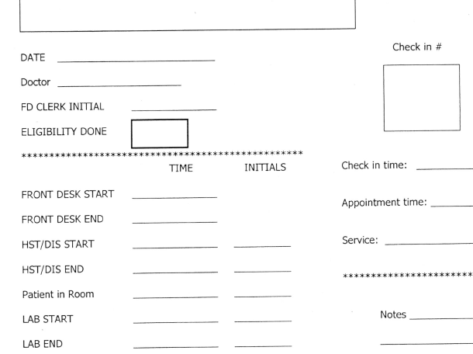
Current Process Data Collection
September – October 2014
Staff Training
Define
Measure

Slide 11
Histogram of Client Cycle Times (Short Visit)
September – October 2014
75.3% of short visits were longer than 45 minutes!!
Define
Measure

Slide 12
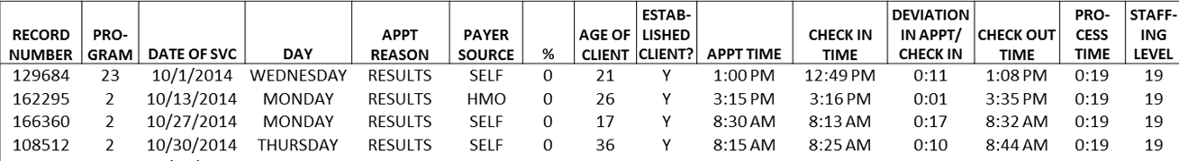
Checksheet - Client Short Visits Sept.-Oct., 2014
10.
Day of the Week
Payer Source
Time of Day
Staffing Level
Number of Clients
New Client
Check-in vs Apt Time
Define
Measure

Slide 13
Analysis of Stratification By Program
Who: Sara Warren
When:
Nov 5, 2014
How:
Client Routers
6.
n: 570 K: 24
R: 153 W: 7
Define
Measure

Slide 14
Analysis of Stratification by Program
Problem Statement: 81% of Prenatal clients experienced cycle times longer than 45 minutes from check-in to check-out.
Target: Reduce the percentage of Prenatal clients with cycle times greater than 45 minutes by half.
Impact: Reaching target will reduce the overall average cycle time to 60 minutes
6.
n: 570 K: 24
R: 153 W: 7
Who: Sara Warren
When:
Nov 5, 2014
How:
Client Routers
7.
8.
9.
11.
Define
Measure

Slide 15
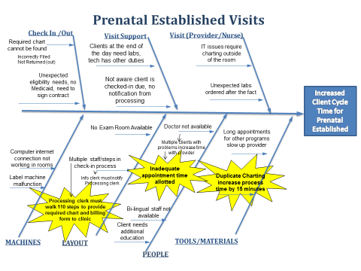


Cause and Effect Diagram
Our Cause and Effect Analysis Revealed 3 Potential Root Causes
Duplicate Charting
110 Steps to Provide Chart
Inadequate Appt. Time
Define
Analyze

Slide 16
Probable Root Cause Verification
Three verified root causes were identified
14.
Define
Analyze

Slide 17

Probable Cause Verification Matrix
After data analysis three root causes were identified regarding client cycle times.
Time studies were conducted on prenatal clients to determine time wasted on root cause issues. This enabled the team to estimate the impact of each root cause on the gap.
The sponsor signed off on the define, measure and analyze steps of this project.
14.
15.
5. ,
11. ,
16.
Define
Improve

Slide 18
Countermeasures Matrix
17.
18.
Three Countermeasures Identified
Define
Analyze
Improve

Slide 19
Countermeasures Matrix
Three Countermeasures Identified
Define
Improve

Slide 20
Countermeasures Matrix
Three Countermeasures Identified
Define
Improve

Slide 21
Barriers and Aids Analysis
Barriers and Aids Analysis was conducted on the 3 selected Practical Methods
19.
Define
Improve

Slide 22
Barriers and Aids Analysis
Define
Improve

Slide 23
Action Plan
Action plan was implemented with sponsor approval.
20.
Define
Analyze
Improve

Slide 24
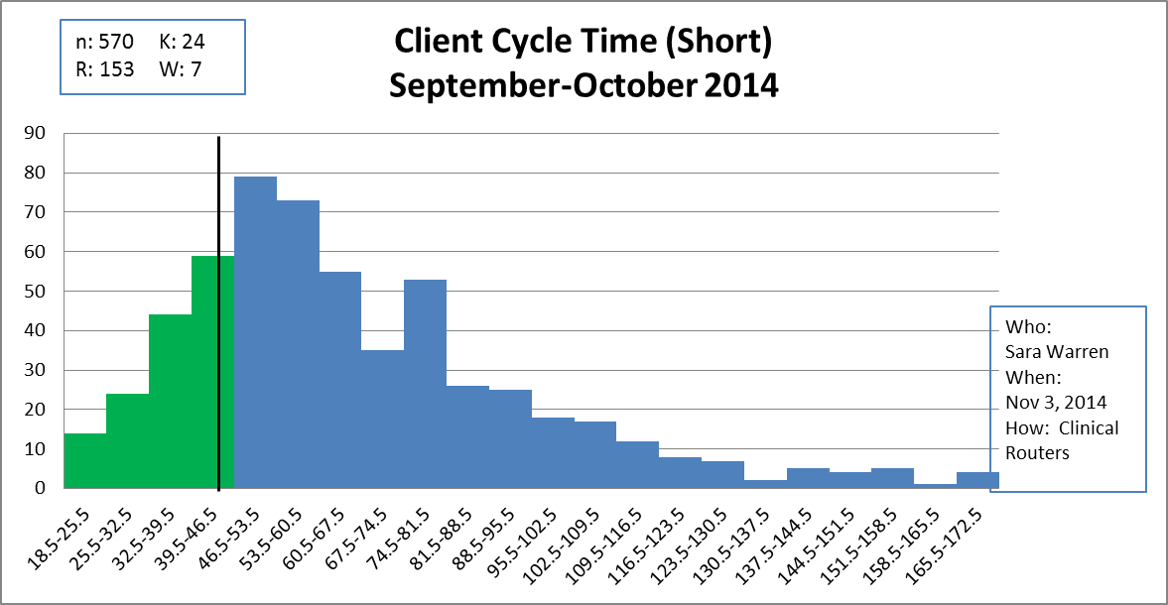
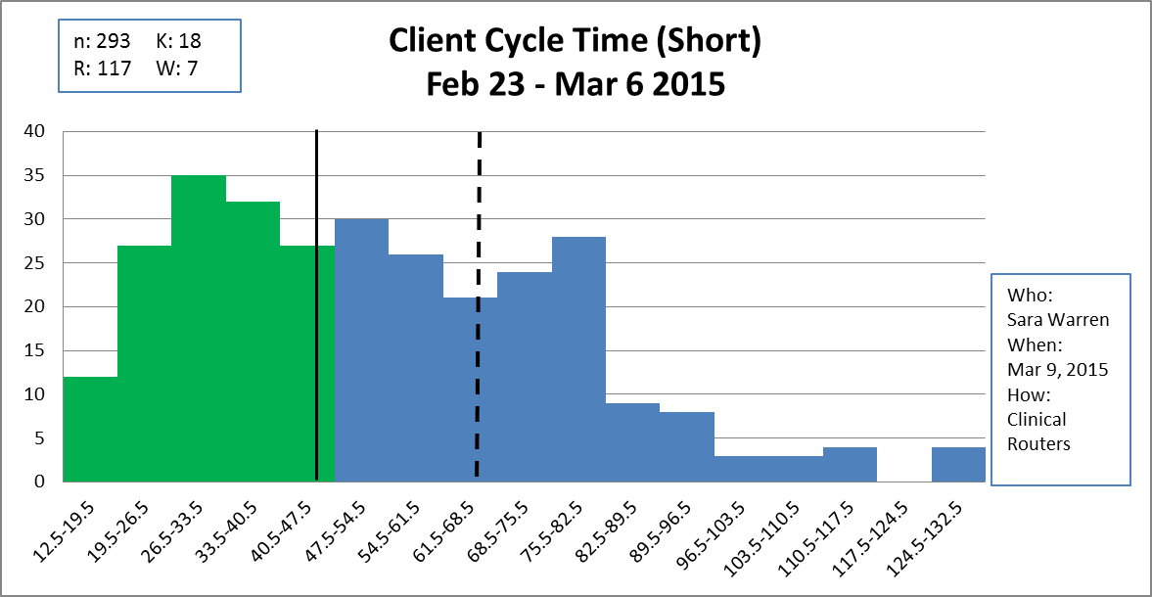
Overall Impact of Countermeasures During Pilot
Before
75% of all visits were over 45 minutes
Benchmark
Average
21% reduction
Benchmark
After
Old Average
58% of visits were over 45 minutes
New Average
Average Cycle Time was reduced from 67 to 53 minutes
21.
Define
Improve

Slide 25


Overall Impact of Countermeasures During Pilot
Countermeasure #3
Change Clinic Schedule
Benchmark
Before with Prenatal as short visit
Average
Benchmark
After w/o Prenatal
Old Average
New Average
Average Cycle Time (w/o Prenatal “short” visit) reduced from 67 to 47 minutes
Define
Improve

Slide 26
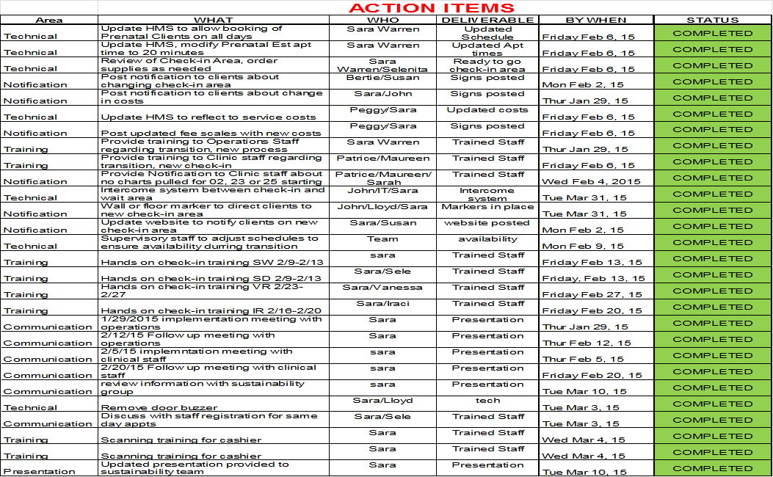
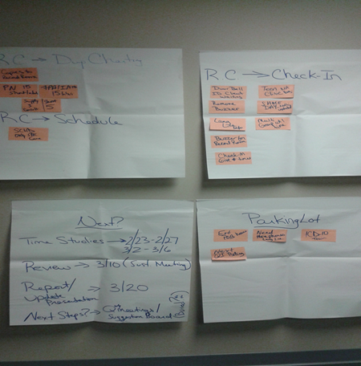
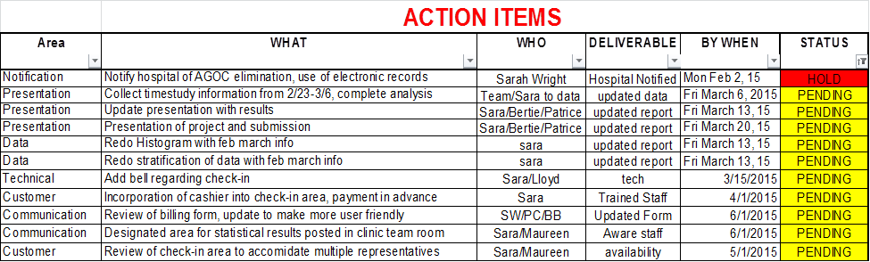
Evaluation / Standardization
Discussion and input from operations/clinical staff regarding pilot period. Identification of next step action plan.
Define
Improve

Slide 27
Evaluation / Standardization
Lessons Learned & Future Plans:
1- Since clinical service may change based on needs of the community, keep updated data to ensure understanding of clinic flow.
2- Changes to process flow require subsequent review and revisions to internal operational forms.
3- It is helpful to ensure continuous communication between operations, clinical and billing staff through establishment of standing quarterly joint meetings.
4- Decreased duplicate charting has also resulted in the cost savings of fewer charts purchased and/or ordered from storage.
5- Keep an open mind. The story continues!
The Sponsor signed off on project action plan and expected results!
22.
23.
Define
Improve

Slide 28
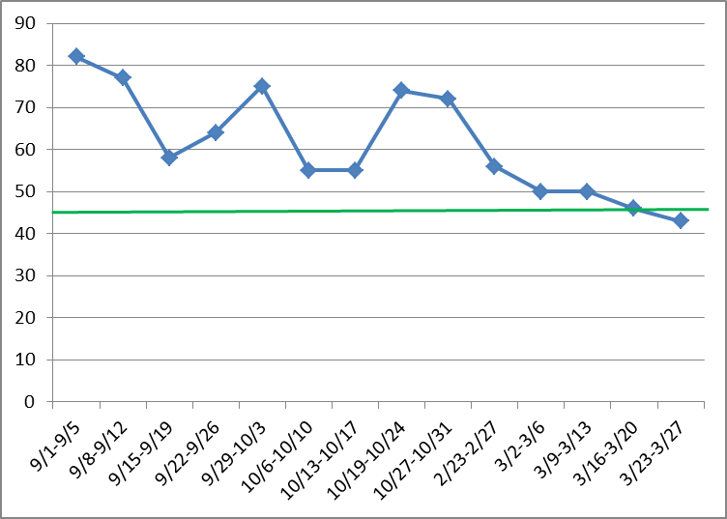
Evaluation / Standardization
Impact on Indicator
Good
Who: Sara Warren
When: 3/30/15
How: HMS Sign-in /Out Report / Routers
Since implementation of countermeasures, time studies have been conducted on a random sampling (10%) of client cycle times. Average cycle time since implementation is currently 46 minutes.
22.
23.
Define
Improve

