Slide 1
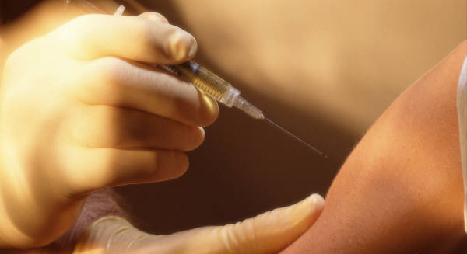
Improving Immunization Process
2012 Quality Improvement

Slide 2
Why Quality Improvement?
Health District interest in systematic evaluation and improvement of its programs and processes
Immunization program already tracking administration errors

Slide 3
Immunizations Project Team
Scott Davis, QI Coordinator TPCHD
Brenda Newell, LICSW HIV/STD/VHO Mgr SHD
Rita Mell, RN, BSN Immunization Mgr SHD
Ivy Giessen, Applications Systems Analyst SHD
Immunization Clinic Staff SHD

Slide 4
Immunization Project Identification

Slide 5
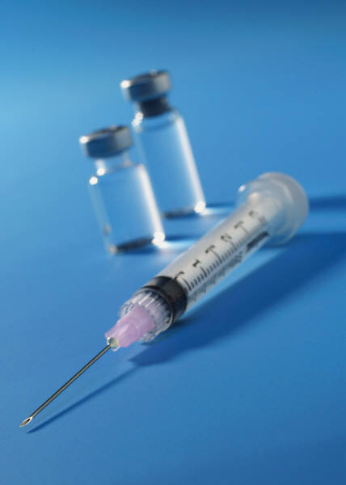
Immunization AIM Statement
Reduce the immunization error rate from 1-2/1000 to less than 1/10,000 administrations by 12/31/2012
30% reduction in error rate from 5.3/1000 to 4/1000 administrations by 12/31/2012

Slide 6
Immunization Project Activities
Introduce QI method to staff – buy in
Obtain baseline data
Define error type
Standardize clinic processes
Establish new work flow

Slide 7
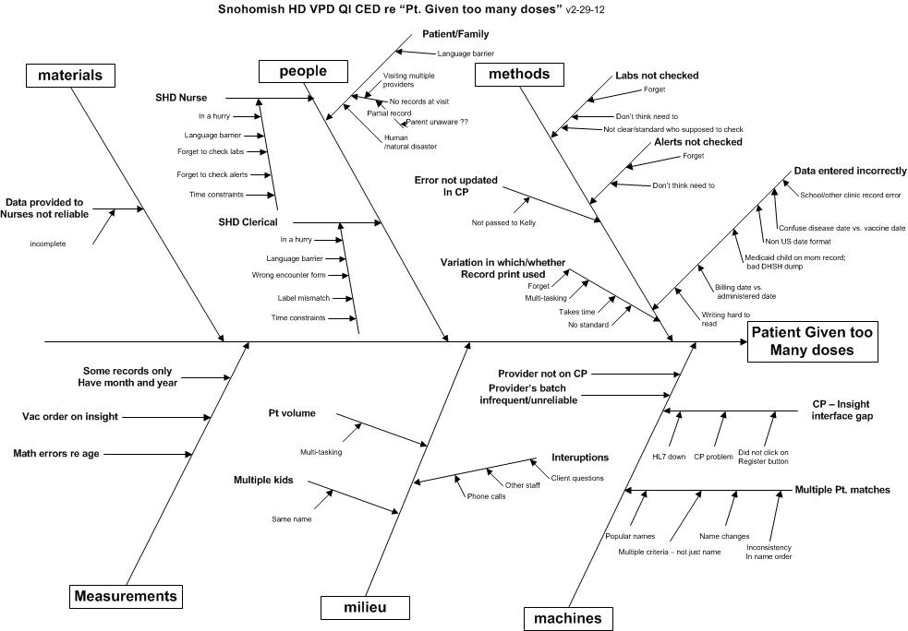
Immunization Root Cause

Slide 8
Immunization Tracking

Slide 9
Immunization Error Type

Slide 10
Immunization Errors

Slide 11
Aim Statement
30% reduction in error
December 2011, baseline 5.3/1000
January—August 2012:
Total doses = 8,466
Total errors = 22
2.5/1000 error rate
53% reduction in error!

Slide 12
Next Steps
Continue monthly analysis of doses administered
Calculate error rate
Remediate repetitive errors
Create atmosphere of excellence
Embrace change

Slide 13
For more information, contact:
Rita Mell, RN, BSN
Phone: 425-339-8626
Email: rmell@snohd.org
www.snohd.org

