Slide 1
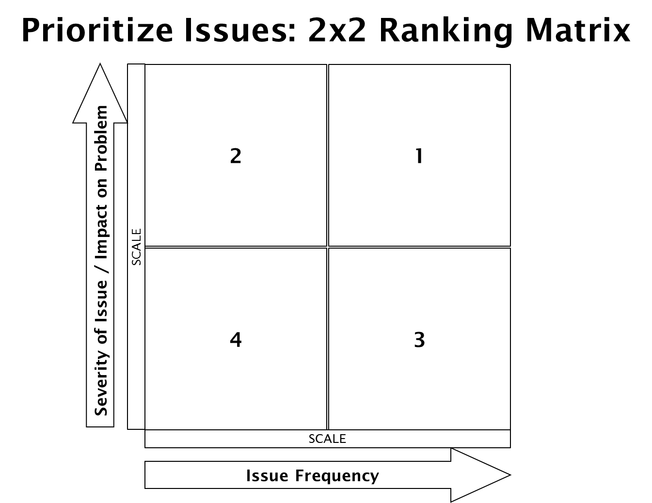
Sometimes staff cut corners & not properly follow procedures resulting in violations when primary mgr. is not on duty
Culture – where some requirements of results not important culturally
Converting theory into action – make it personal
CV marked – mgr. does not change procedure that resulted in violation just tries not to get caught again
Don't retain what owner/operator has been told by inspector
Mgr. doesn’t demonstrate knowledge during the inspection
Operator wants help with staff training but EHS not allowed to do it
Staff doesn’t check for cleanliness
Priority gets lost in report in daily jobs
Business is failing
Too busy to deal with
Take too many food temps.
PIC not delegating
Operators do not know what violations are P/PF
Manager doe not want to talk to inspector
Language barrier
Don’t care
Managers too busy to review report or ask ?s
Employees don’t date
Wrong date on items
We don’t follow up to see if CDI resulted in long term improvements
Just in time preparation
Don’t prepare for inspection daily
Cold Holding temperatures not maintained
Lack of management experience, management control
Manager confused with importance of P/PF vs. core violations
Differences in training received - serve safe doesn’t tell everything need to know
Manager turnover & knowledge not passed on; Staff turnover & not trained
Don’t have power
Correction may not reflect actual change & temporary only
Employees don’t care; don’t understand why they should care
Culture of not taking is seriously
No time to inspect your work
Don’t have labels for all bottles
Tempos. Not taken routinely
Can’t find / don't have therms.
Don’t have right way to date to sty with food (proper procedures)
As long as score is good – we really get attention
Owner focused on public – customer 1st, safety 2nd
Personal not recording Ph records daily
Internal QA – consistency of REHS
No buy-in government is bad & inspectors are there to ruin business
Rush hour
Trying to correct all violations during inspection
Report is a lot of small writing with words they don’t understand
Menu changes create ‘new’ issues resulting in PPF violations
Not a fire able offense
Manager does not follow with CHA stating violations are completed
A lot do not call – up to CHA to go by
Operators or staff lack basic science education – don’t get that something in deeper pan cools slower
Manager makes corrections according to what is easier to do
At permit – regulations are not provided
Food handlers lack knowledge
Low mental threshold / capacity

Slide 2
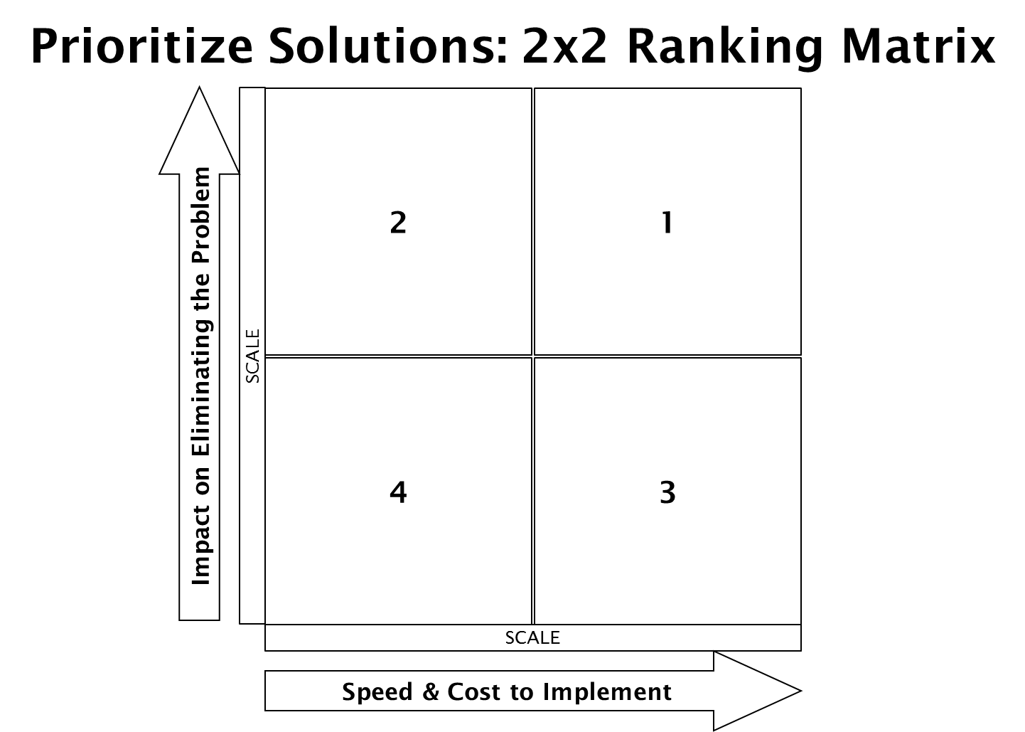
Create environment that really everyday
Use Permit action
Change in thinking
2 infractions – fire able offense
Call place letting them know you will be follow up that week
Going by when the score is not on the line & when they are not as busy may improve relationship
Provide class re violations
Make a later appt. to go over grade sheet
Call out policy & enforce it
Buy-in from all employees
Be proactive to clear up issues
Add EH staff
Date Stamping (Put date supplies at point of use, mgr. show importance, date everything, use price gun, change color of date code
Follow up on non-CDI (develop tool to log & follow up, set guidelines for p/pf that must have follow up, go by visit when in the area/strategic inspection planning)
Active Manager Control (teach them what this is)
Improve relationships (Eat where inspect, speak more to all employees, keep food safety in the fore-front of all employees)
P/PF Education (understand the what & why of violations, training once a year, checklist for mgrs., educate what these violations are, operators don’t know what is a p/pf vs. core Increase understand for all employees)
Email (email last violations & links, email inspection report back to rest. Late, routine communication, email before next inspection – attach previous violations, ask EH desk to call restaurants and get emails – create email db.)
Reduce # of inspection concentration on high violation establishments
Training (create How to instructions for high priority violations
Preventative Maintenance every 3-6 months
Call in 2nd shift
I think more places need to be using temp. logs
Publicize when corrections made – on visit
Employee incentive
Have materials on hand for them to buy
Do follow-up to confirm corrections - including positives
Can the 1st pare of the inspection sheet be more helpful?
Leave phone # for them to call if ?s
Recommend Mgr. walk through daily
Self inspection sheet
Explain what grade ‘means’ on our website (amount of risk taking)
Do we need to education public about what the grade means? (newspaper, website)
Provide labels for sanitizers
Digital clock with date, place it next to calendar
Inspection notes in more detail
Do follow up to confirm corrections complete
Visit documented under item #s so auto populates for next inspection
Leave phone # for them to call if questions
When confused: suggest ‘made by’ date
Staff do not toss at night - Recommend manager to clean up night shift (dating)
Change when during the qtr. inspections are being done
Time between qtlry inspections vary

