Slide 1
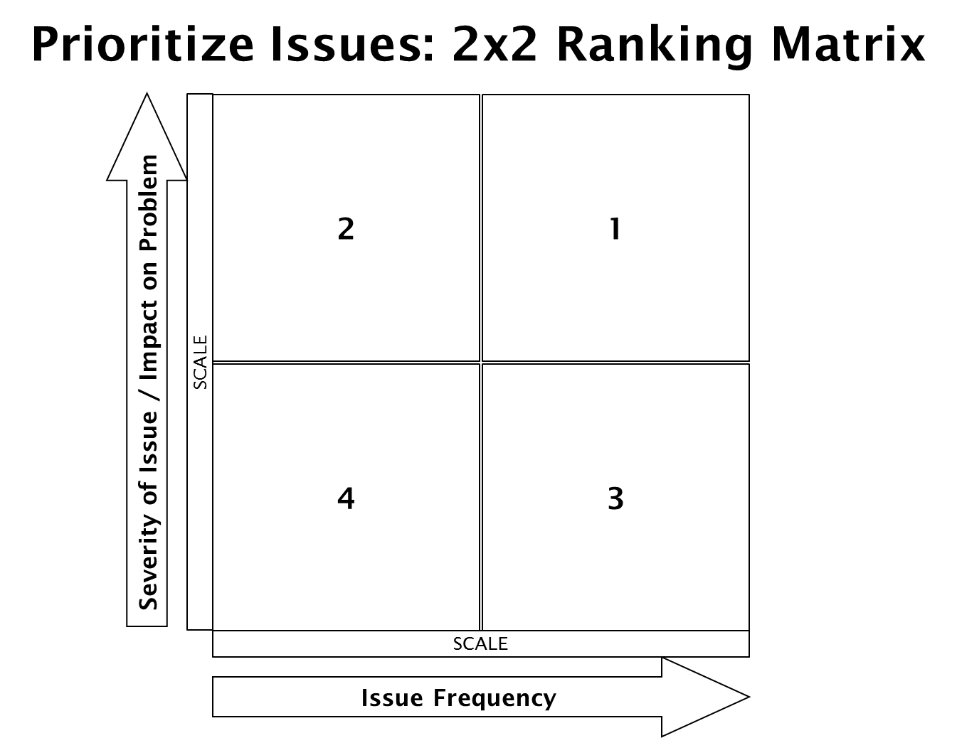
Wrong or damaged item
Should use a separate order form for different budget codes?
Item going to the wrong location or site
Order items that we know won’t get approved
Inconsistent process across the department
Different forms for all orders
Paper forms
Calling to clarifying orders
No process baseline data
Frequent staff change (new hire training)
Inconsistent item #s - Where should we be looking for items (on-line, catalog)
Accounting cannot receive excel files
Inspecting the order after accounting has inspected the order
Providing the wrong task #
Old orders not accessible
Receipt information requirement (original? scan?)
Need someone to check the inventory levels
For date need (would like to specifics)
Don’t know expected time of arrival once order is placed
Multiple process requirements for notification of delivery per division
Don’t always receive order confirmation
Abiding with regulations (Perception or Reality?)
Variance: Sometimes staff provides item specifics, sometime supr. has to determine specifics
Sending out emails
Duplicate keying on websites
Printing off order forms
Process flow – email to supr for approval, the supr forwards to acctg to order it, orders printed out and delivered to mailbox
Division director approving order

Slide 2
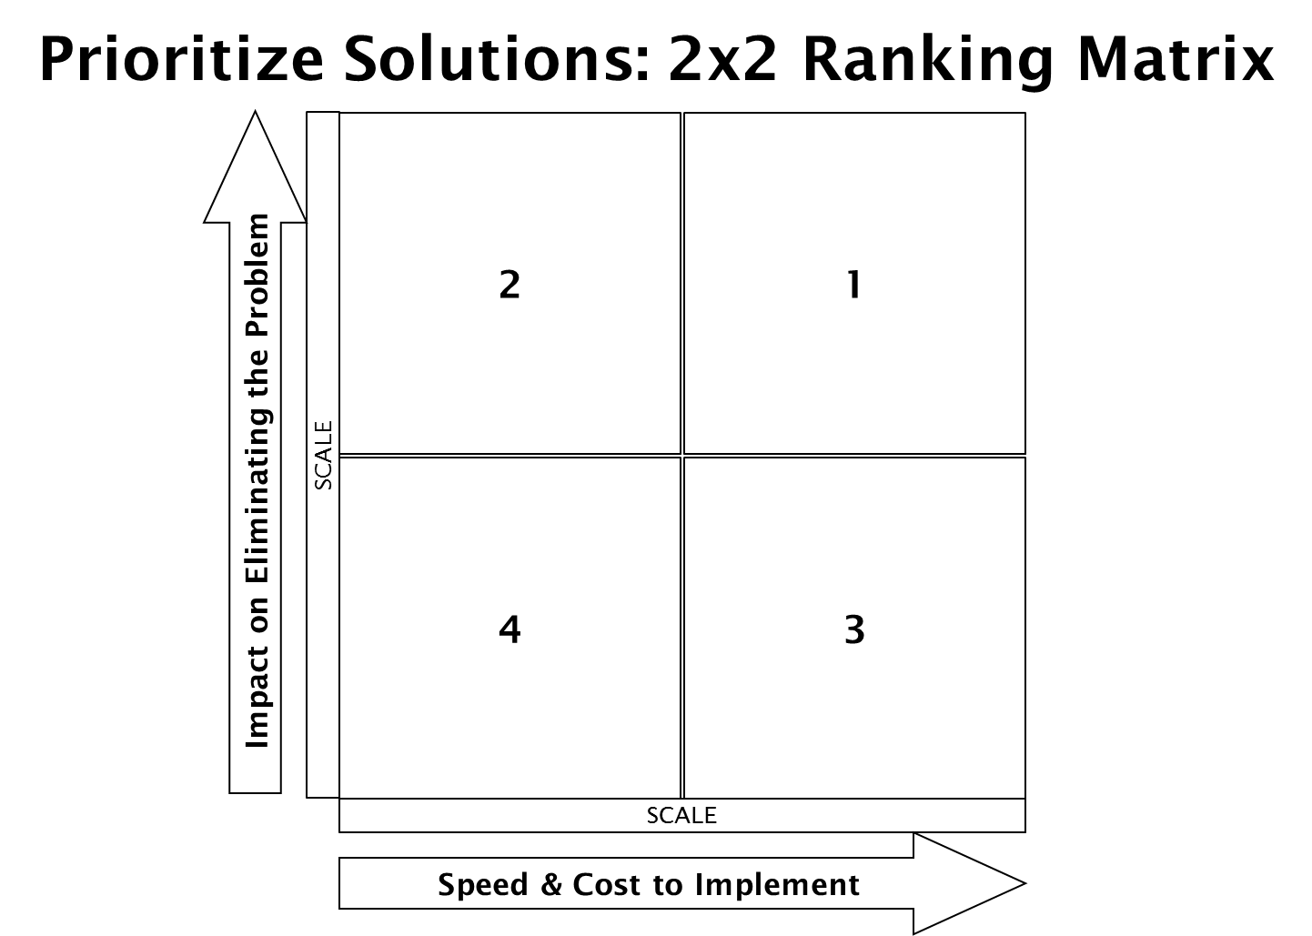
E-file form (workflow in share point)
Share point work flow
Accounting approval checklist to get complete clarity
Sites order together rather than divisions
Label item with correct location – send out a new list of who is who
Training staff on how to receive an order
Specific person for receiving
Std. order form on vendor site for prgrams to put in orders
All Program Orderers need to know the vendors for all std. items ordered
Listing of links for std. places we order from
Increase p-card limits
Provide program orderers p-cards
Establish purchasing threshold so that Dir approval is not required
Give Orderers div. budget costs & limits
Shred all not preferred catalogs
Office Max – provide access to Office Max workplace
Create procedure/protocol for orders
Order according to location with direct delivery
Establish an ordering schedule
Order form (1 per loc) with std list; order 1/mth
Provide budget codes on order form
Need consistent terminlogou on orders (swabee vs. prof. towels)
Acctg provide standardized form with std. suppliers from std vendors
Establish re-order points with kanban cards (card include item specifications)

Slide 3
