Slide 1
Cabarrus Health Alliance
WIC LEAN KAIZEN EVENT
QUALITY IMPROVEMENT PROJECT
2010-11

Slide 2
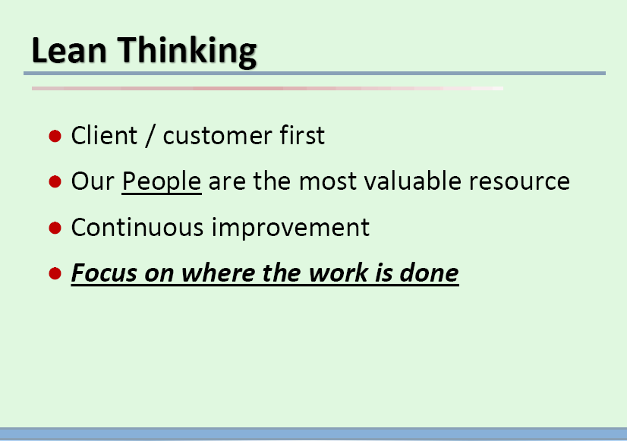

Slide 3
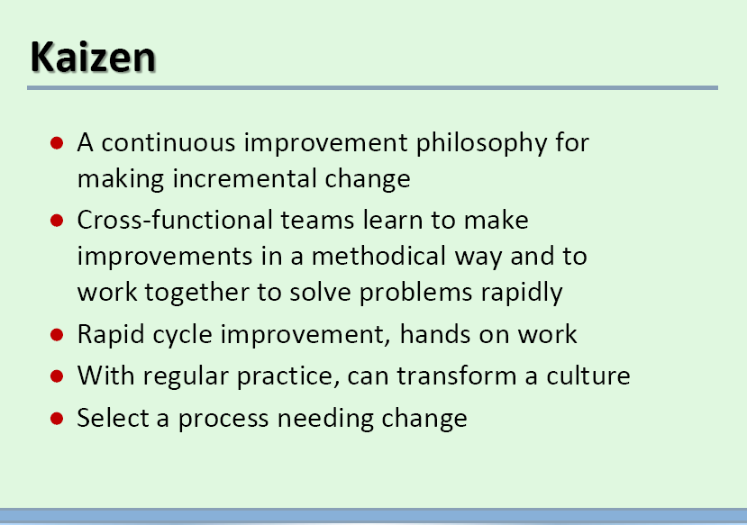
Notes:
Process needing change—WIC Open access

Slide 4
TEAM MEMBERS
Sponsor/Champion
Cross-functional Representatives
Cappie Stanley
Betty Braxton, HR
Bobbie Rowe, Clinic
Cindy Walker , Clinic
Julie Hurt , Regional Consultant
Tammie Harkey, Finance
WIC Stakeholders
Flor de Liz Bustos
Kathleen Tucker
Regina Kurtz
Susan Anderson

Slide 5
WIC AIM STATEMENT
The Cabarrus Health Alliance WIC clinic will make major improvements in access and efficiency for our participants while at the same time improving staff satisfaction. We will continue to improve our open access scheduling system over the next year by identifying processes that will eliminate unnecessary delays in the system and benefit our participants and staff. The goals we hope to reach by [March 31st, 2011] are as follows:
Increase participant satisfaction to 96% or higher – Baseline: 89%
Keep appointment availability to 0 days by making 100% of participant visits same day access
90% of staff strongly agree they would recommend our WIC department as a great place to work – Baseline: 75% agree, 19% strongly agree
Increase staff satisfaction to 85% or higher– Baseline: 69%
At least four full-time WIC staff will be formally trained in the Kaizen quality improvement process.

Slide 6
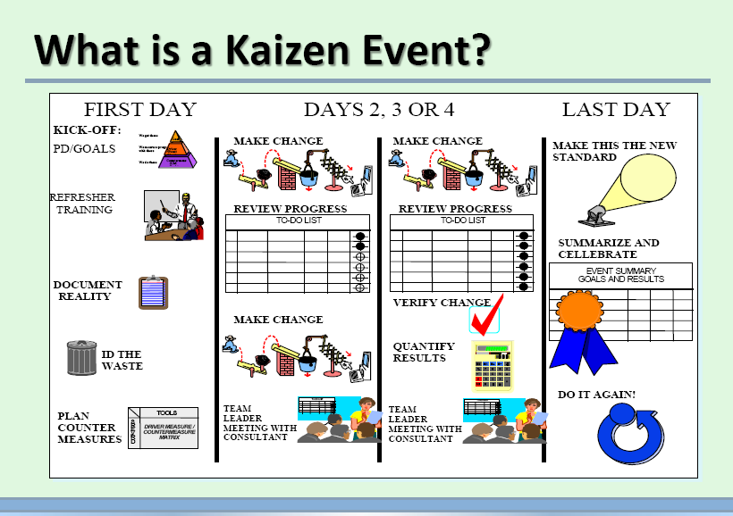

Slide 7
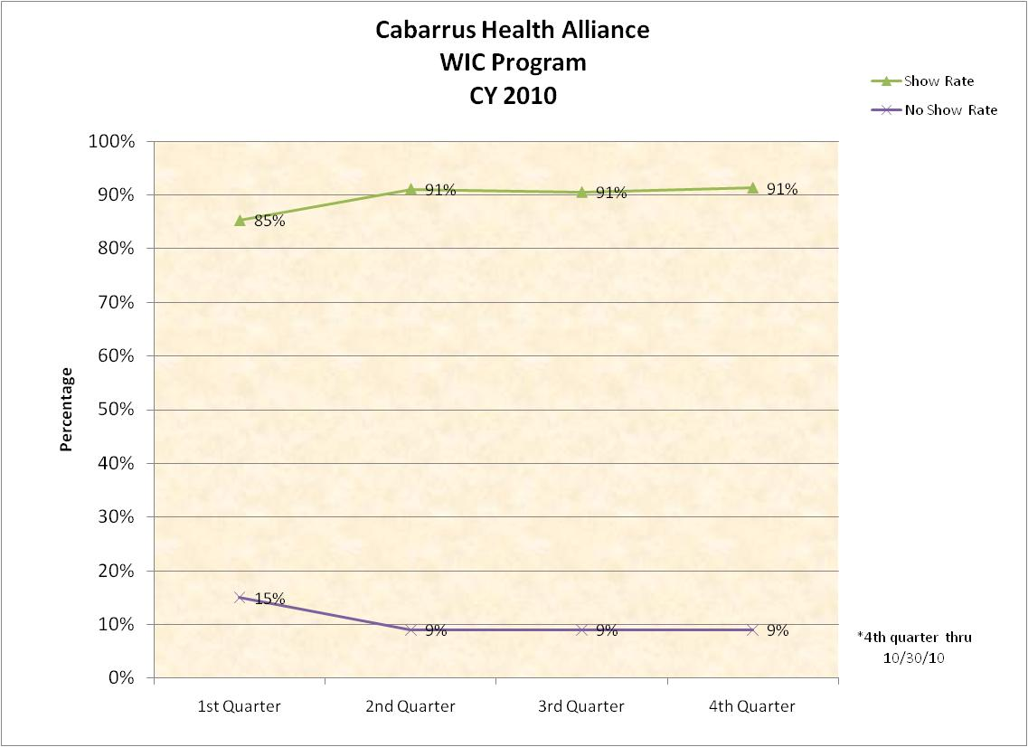

Slide 8
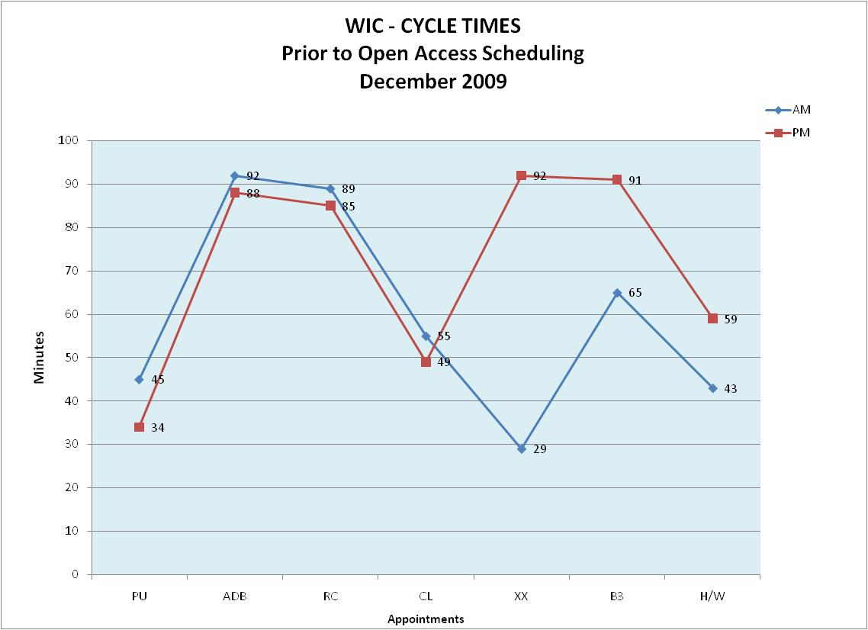

Slide 9
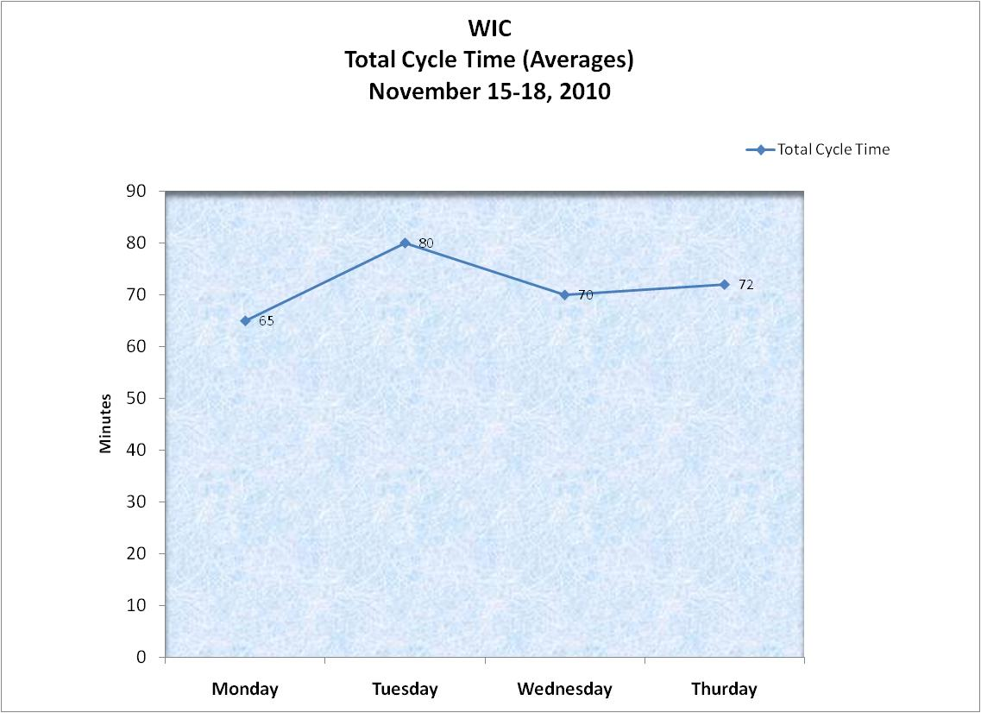

Slide 10
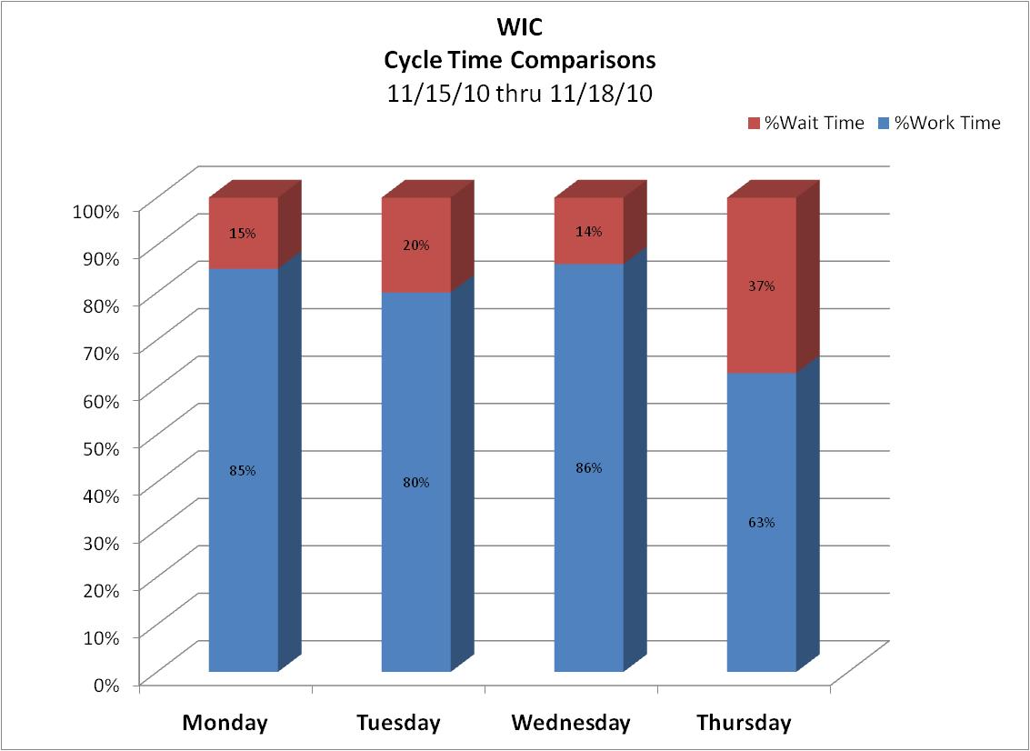

Slide 11
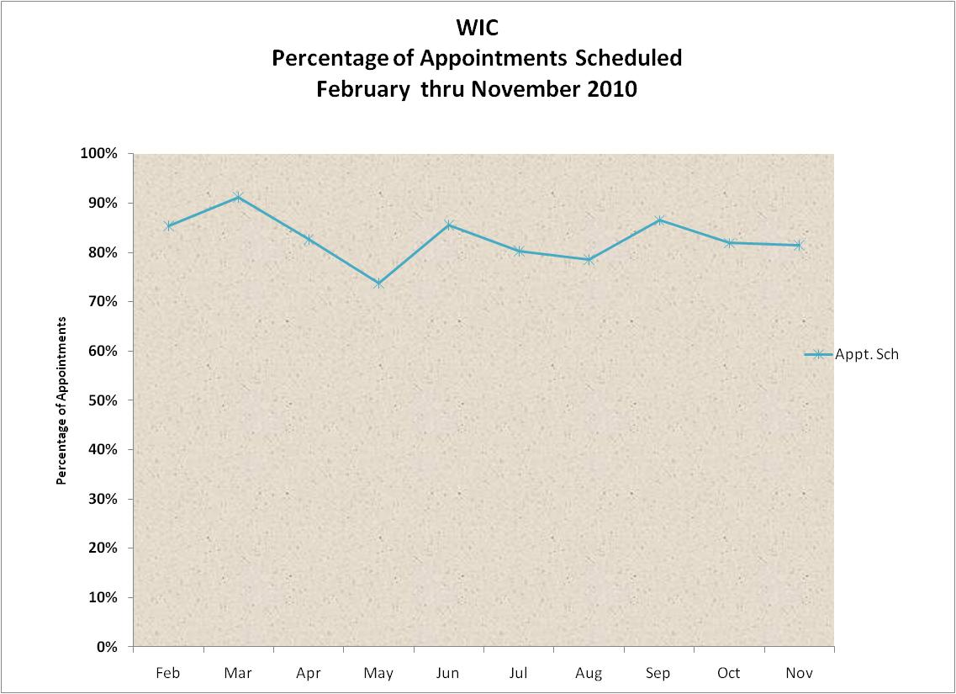

Slide 12
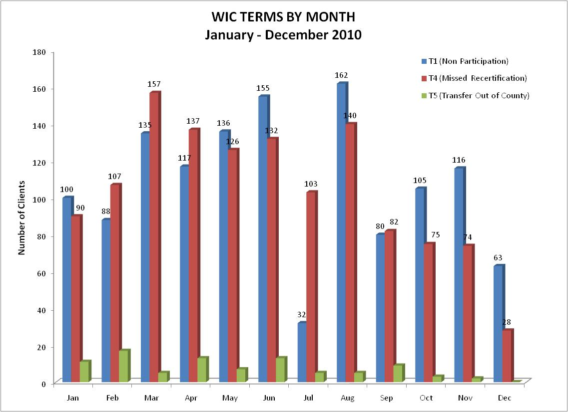
Rev 12.10.2010

Slide 13
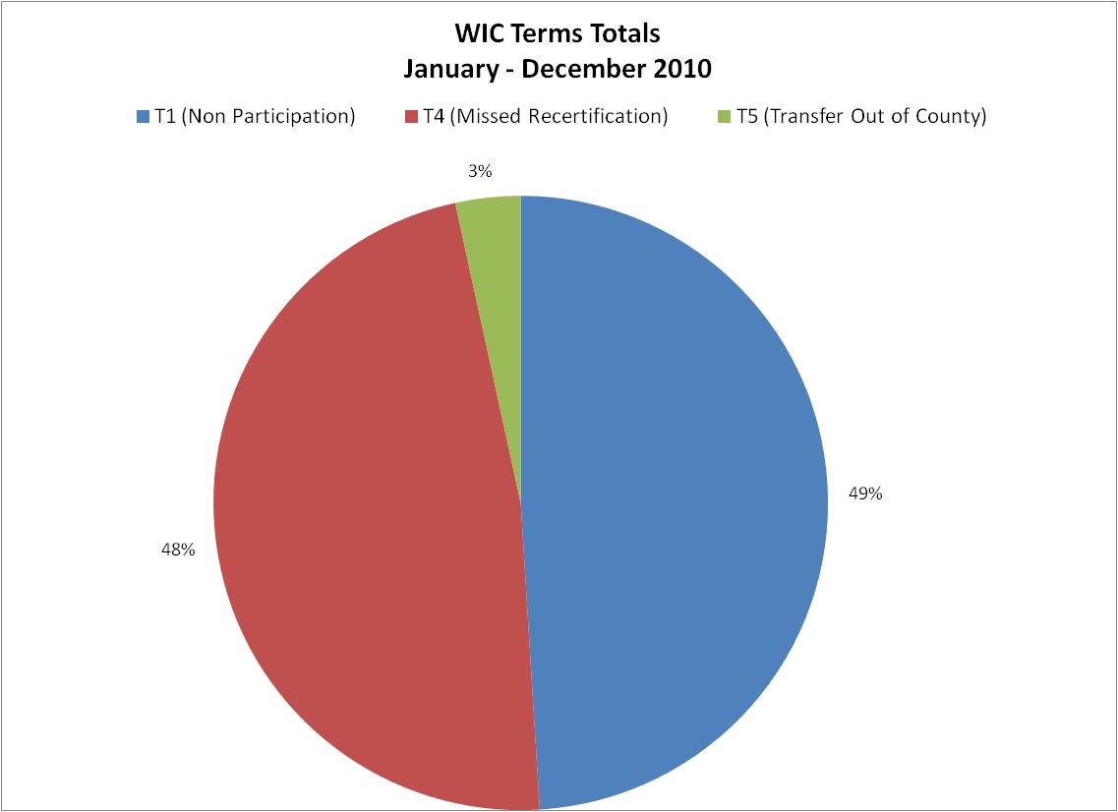
Rev 12.10.2010

Slide 14
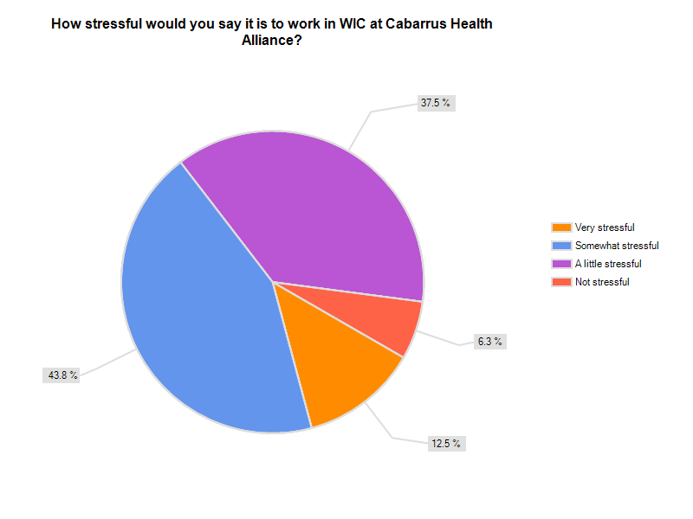

Slide 15
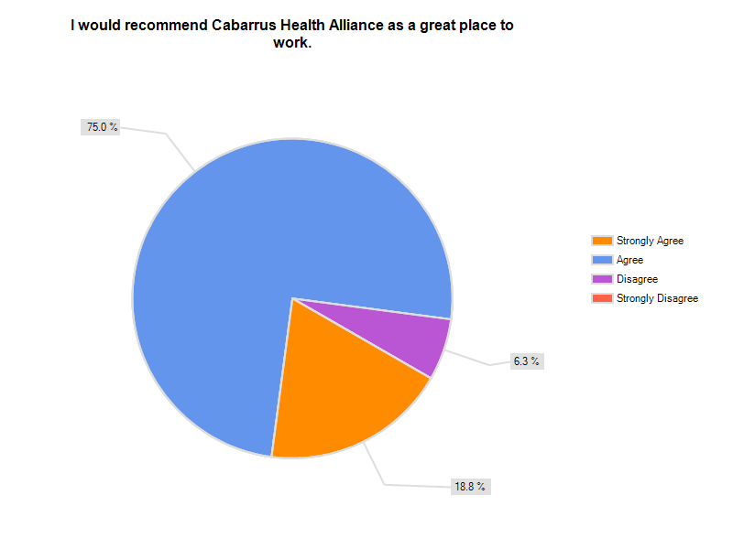

Slide 16
PDSAs

Slide 17
Receptionist Area
To test the effectiveness of placing a receptionist in the WIC lobby to route traffic, instruct clients, answer question and distribute paperwork.
Equip area with supplies
  flu mask, forms, phone, desk, chair, computer, walkie-talkie, hand sanitizer (non-alcoholic),etc

Slide 18
Receptionist Area (cont’d)
Clerical staff decided to keep “receptionist” position inside the issuing area to allow that person to be more flexible in their duties.

Slide 19
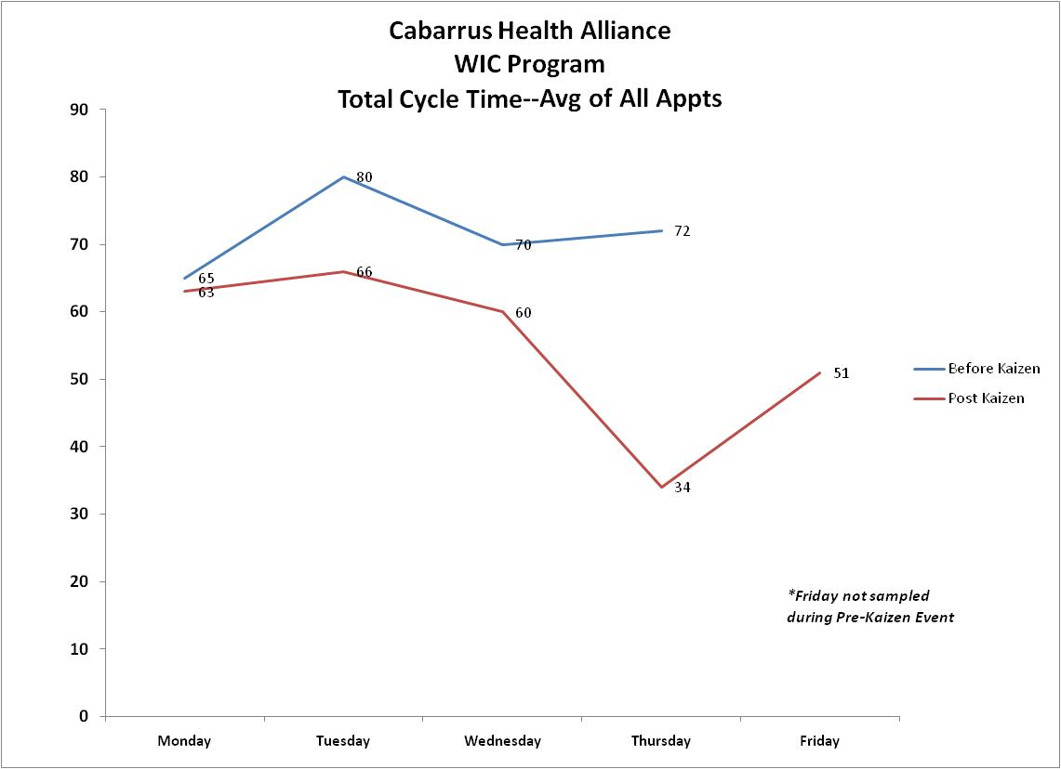

Slide 20
Scheduling
Modify Open Access appointments to accommodate a special subset of participants with school/work or transportation issues
Pre-book class appointments
Pre-book appointments for people with special problems

Slide 21
Scheduling
For the last 9 weeks there have been open appointments every day.
When appointments have been filled in Kannapolis and there are available appointments at Logan, the participant is offered the choice to go there.
XOAW appointments for each of the pick-up weeks for each of the 3 cycles in Kannapolis being reviewed to see exactly how evenly spaced out the appointments are.

Slide 26
WIC AIM STATEMENT
The Cabarrus Heath Alliance WIC clinic will make major improvements in access and efficiency for our participants while at the same time improving staff satisfaction. We will continue to improve our open access scheduling system over the next year by identifying processes that will eliminate unnecessary delays in the system and benefit our participants and staff. The goals we hope to reach by [March 31st, 2011] are as follows:
Increase participant satisfaction to 96% or higher – Baseline: 89%; Post: 95.5%
Keep appointment availability to 0 days by making 100% of participant visits same day access Met
90% of staff strongly agree they would recommend our WIC department as a great place to work – Baseline: 75% agree, 19% strongly agree;
        Post: 53% agree, 16% strongly agree
Increase staff satisfaction to 85% or higher– Baseline: 69%; Post: 60%
At least four full-time WIC staff will be formally trained in the Kaizen quality improvement process. Met

Slide 27
NewsPaper Action Items
Cycle time, completed
Revise WIC Instruction Wallet, completed
Update WIC on Cabarrus Health Alliance Website, completed
Improve website to be more informative, more inactive, prettier, more language friendly, and income calculator, questionnaire and forms, completed in English

Slide 28
NewsPaper Action Items
Data (cycle times, customer service) ongoing
Create scripts and train staff on to use the appointment process, completed
Review with staff the confidentiality/HIPPA, completed

Slide 29
Next Steps
Dedicated vitals staff
Cross training of staff throughout the WIC dept.
Signage to assist participants and staff with the flow
Evaluate appointment mix
Evaluate contingence plan
Investigate flex staffing and rolling morning starts

