Slide 1
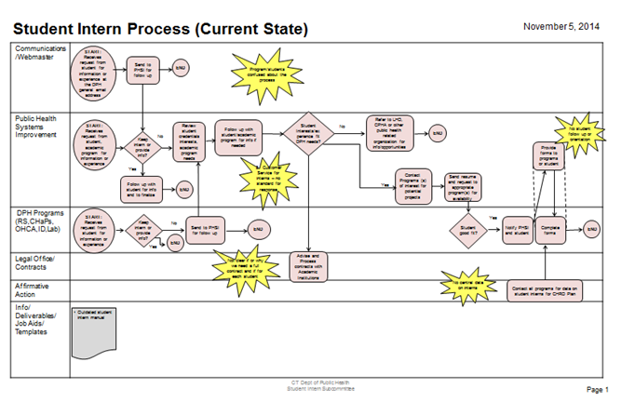
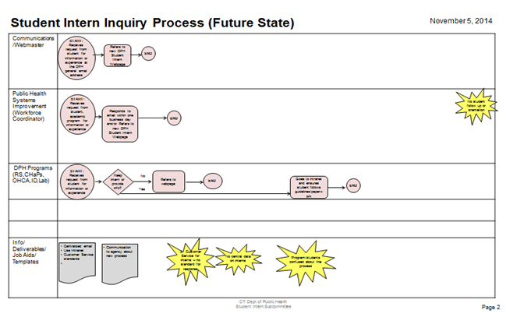
Streamlining the Student Internship Process
Objective/Charter Increase the number and fairness of opportunities for students seeking career development or practical training in public health fields, while decreasing the amount of staff time administering the process.
Opportunity Statement Improve efforts to promote public health as an attractive career choice and open new pathways for agency recruiting.
Visual Stream Mapping – Number of Steps
1-3 Months
Monthly internal meetings
Identify goals
Research other state, federal agency internship processes
Map current and future process
4-8 Months
Develop information and policies to post on the Internet and Intranet
Build and test forms
Build customer feedback surveys
Build information routing and method for administration through volunteer coordinators
9-12 Months
Pilot new process and incorporate feedback
Launch new process and communicate changes to staff, students and academic programs
Monitor customer feedback from surveys, and data for metrics
Metrics
Value of Customer - # of students that secure an internship; % of students that secure an internship
Value of Employee - # minutes/day spent administering the process
Value of Process - # of information requests received; % of surveys indicating process is better
Major Findings/Comments
Reduced the number of steps in placing students from approximately 14 to 4
Technology is available to automate matching students with available DPH projects.
A middle person to match students and projects is not needed and given diminishing resources, was inhibiting visibility and fairness of opportunity for students and programs seeking interns.
Currently monitoring time reductions in administering new process, number of placements, number of information requests, and customer feedback surveys.

