Slide 1
Welcome to our Lean RPI for Occupational Health Report Out
January 26th – February 2nd Clackamas County
Public Health & Health Centers Divisions

Slide 2
Occupational Health Project: Lean RPI Objectives (Pam)
TO: | Implement a process for occupational health needs of both division’s employees to meet federal, state and local requirements.
FOR: | Minimizing the health risk of each division’s personnel.
SO THAT: | Staff and patients/clients are safe and healthy Clackamas County’s liability risks are limited (or eliminated)
HOW: | Measure of Success (under development) Onboarding: timeliness of processing occupational health requirements for new hires—30 days or less from established start dates onboarding requirements for new hires will be completed. Ongoing: annual requirements are followed and completed fully—the length of time from managers/supervisors being provided a list of ongoing occupational health needs for all employees (target= 30 days upon notification for each employee).

Slide 3
Lean RPI Objectives (Pam)
BY: | Activities by Day Day 1: Focus the team; learn requirements through meetings with SMEs; affinity charting Day 2: Affinity charting continued; Process mapping; Cost analysis; determine options Day 3: Gain consensus and finalize recommendations; present recommendations and seek leadership feedback / support Day 4: Develop new process-- flow charts; best methods documented; training & communication plan

Slide 4
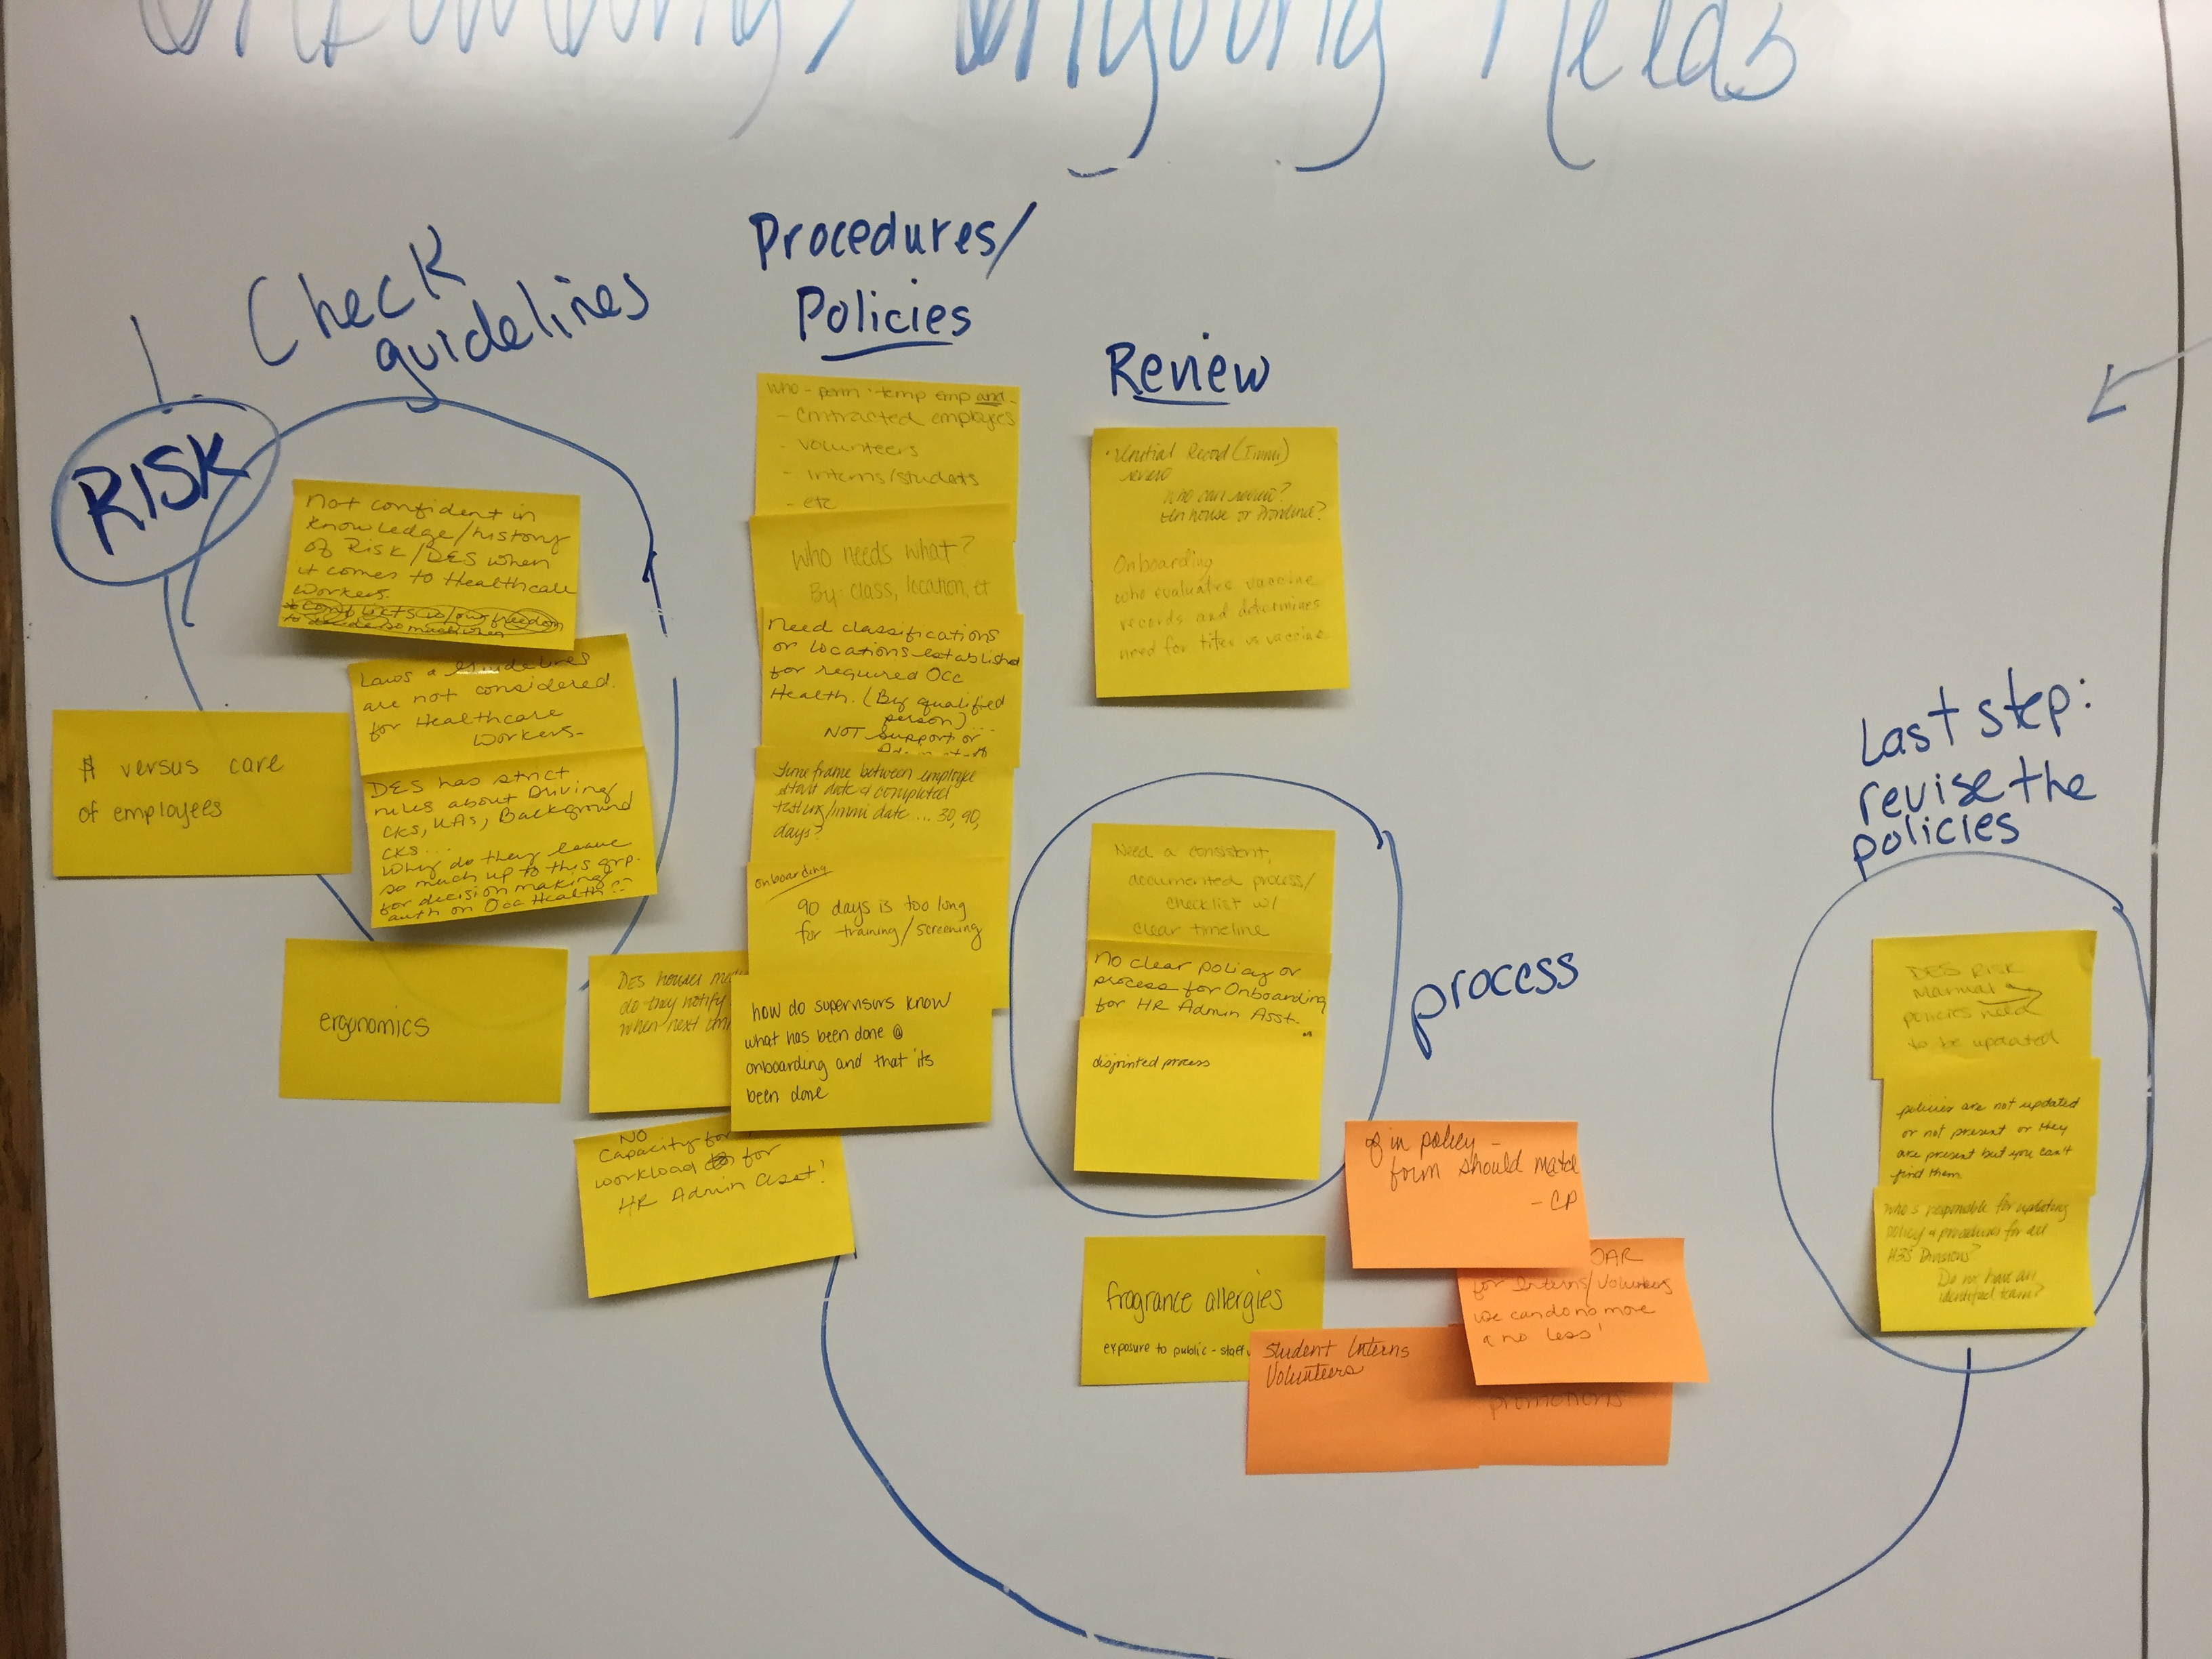
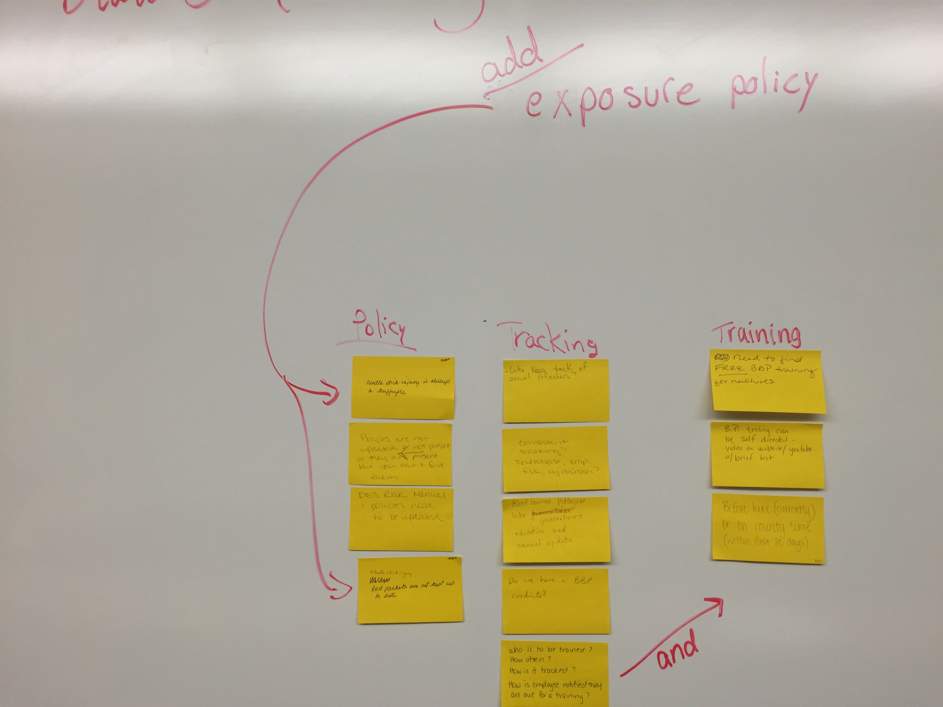
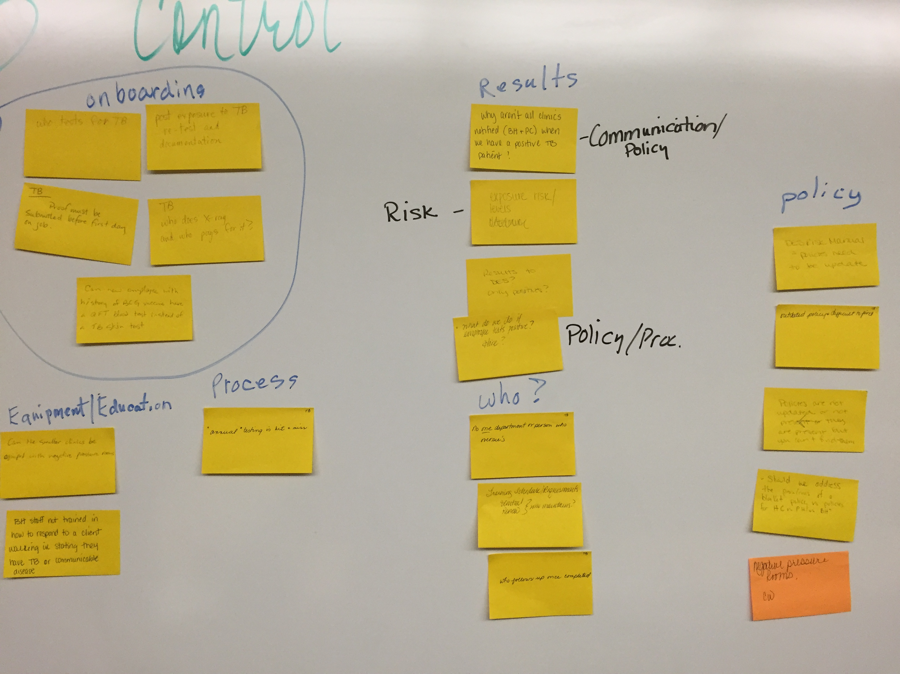
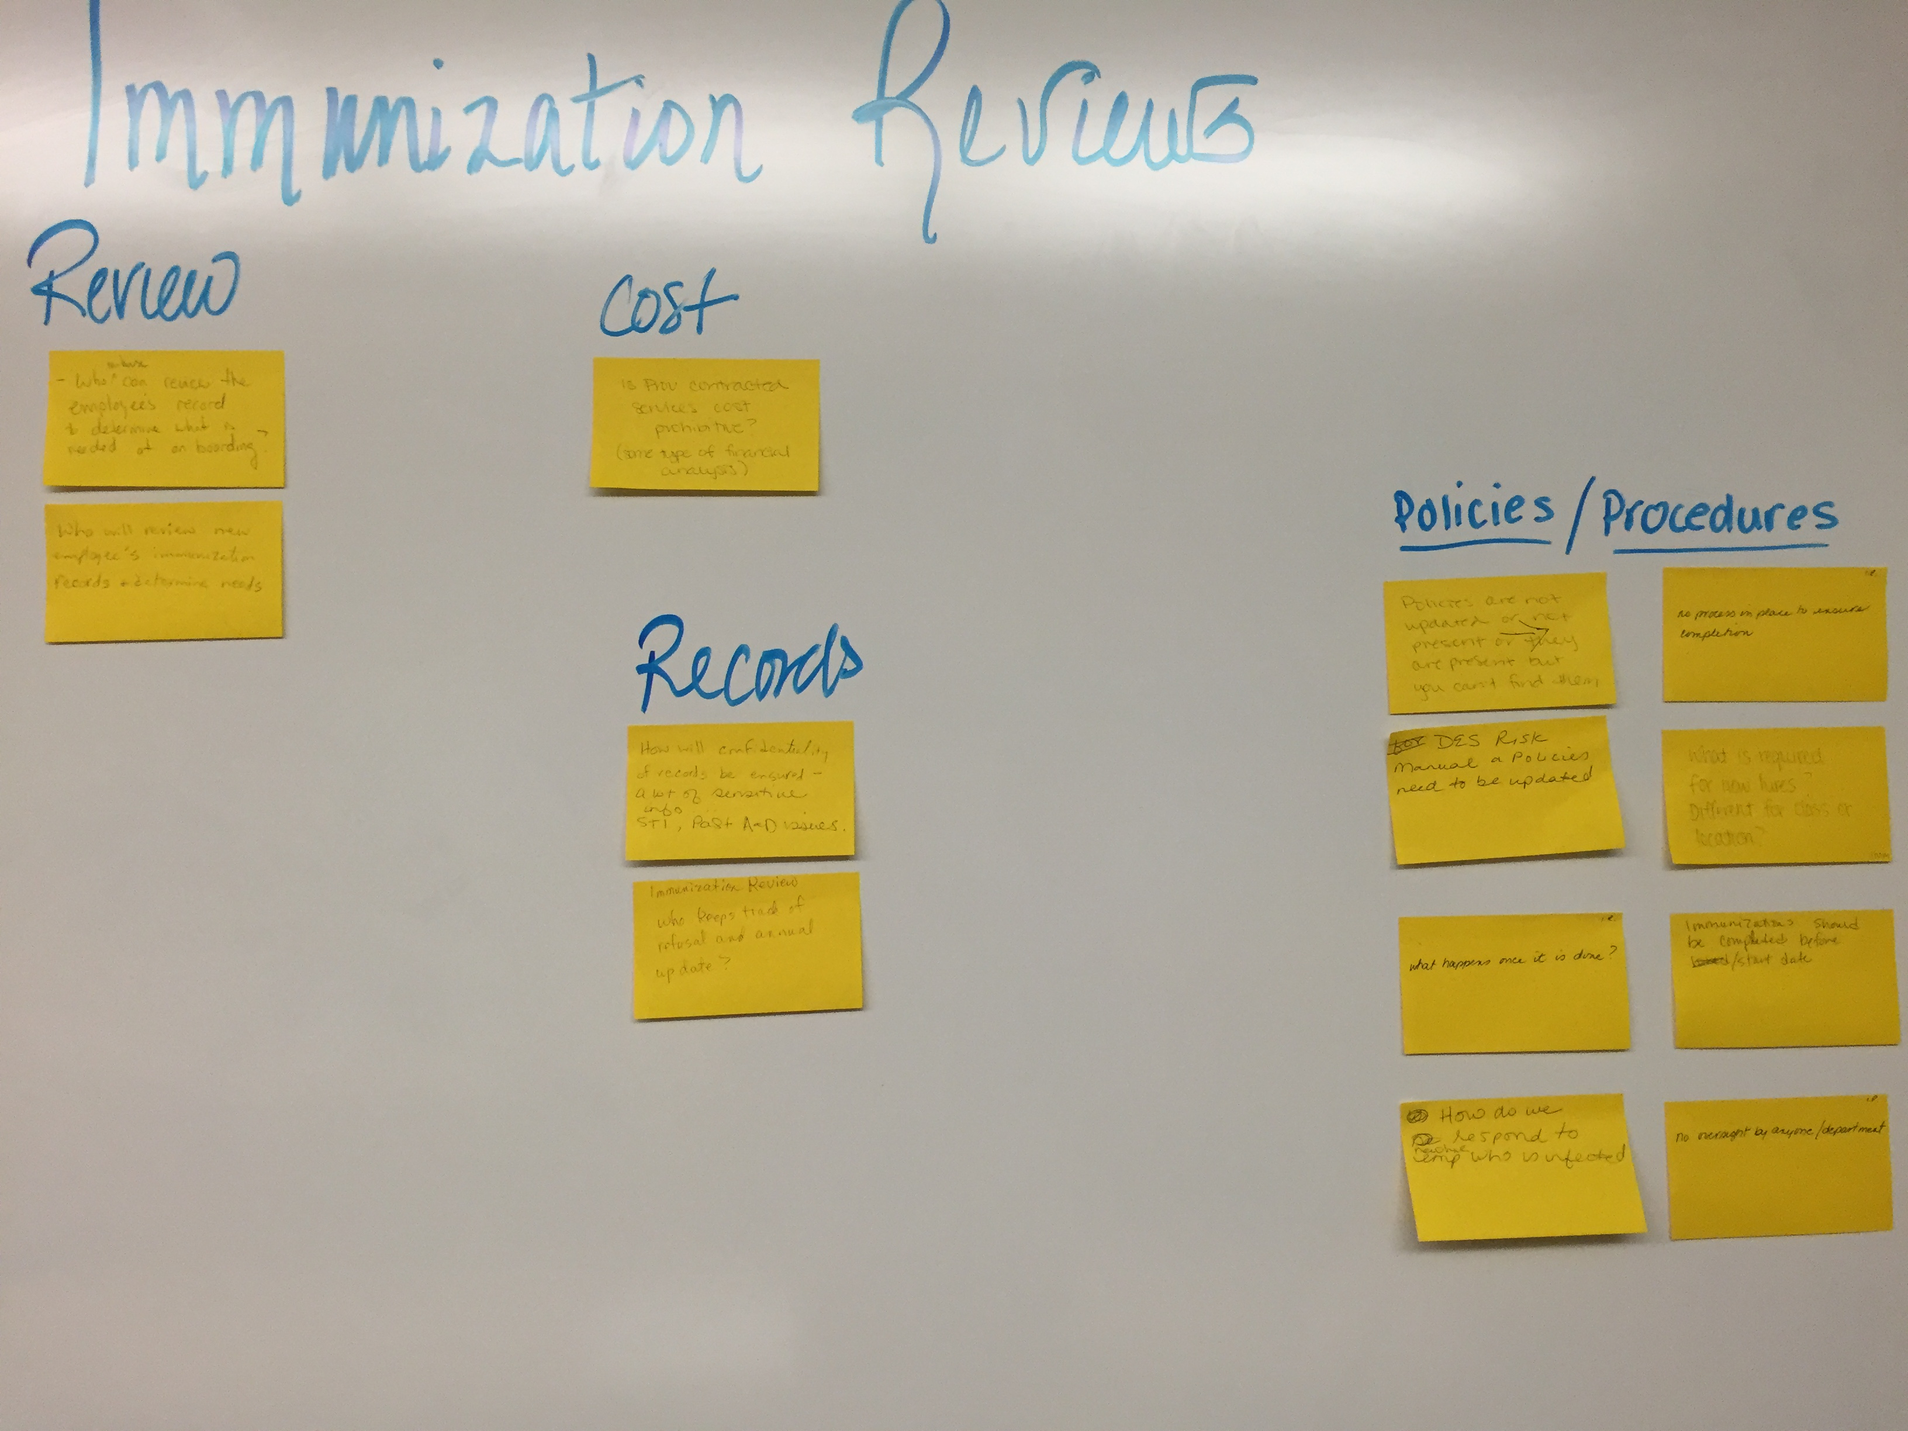
Affinity Charting (Paula)

Slide 5
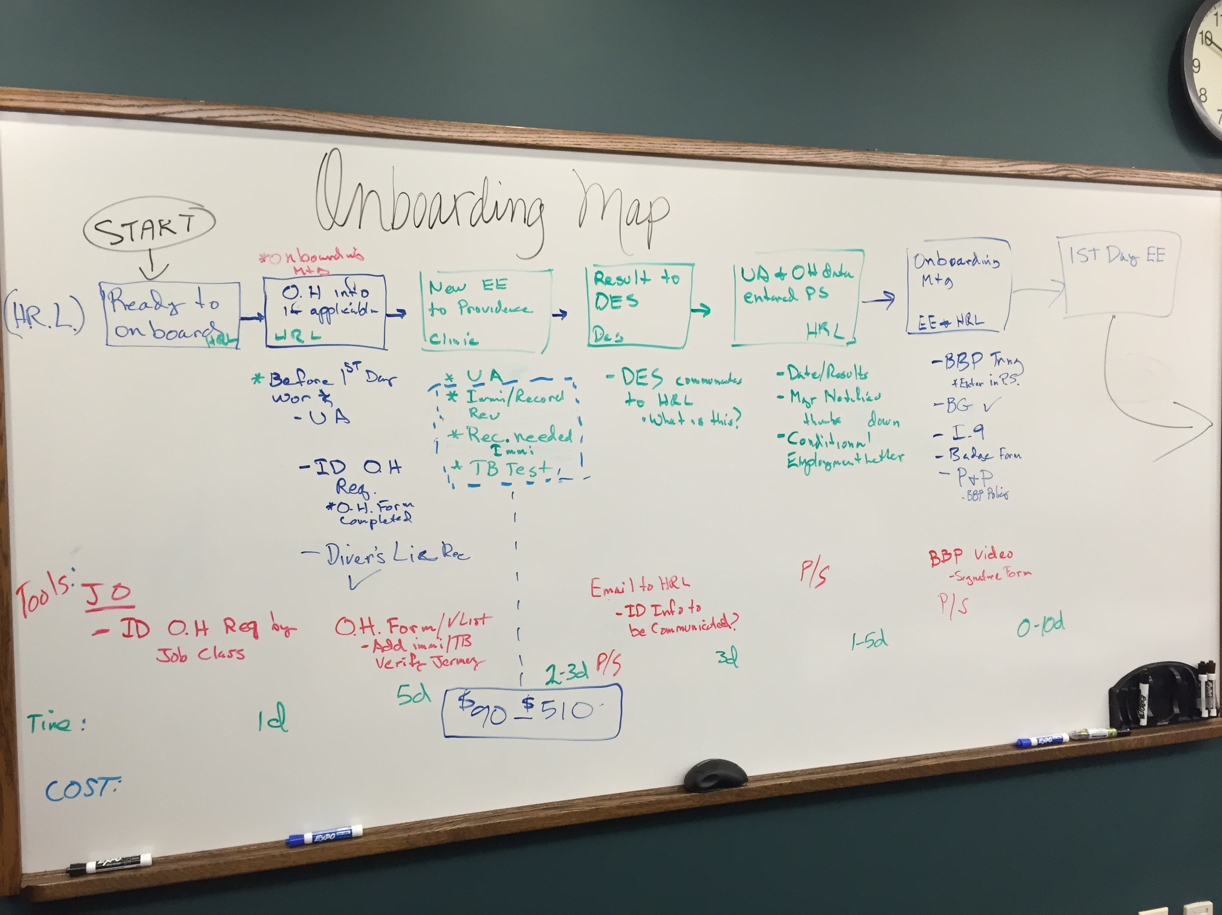
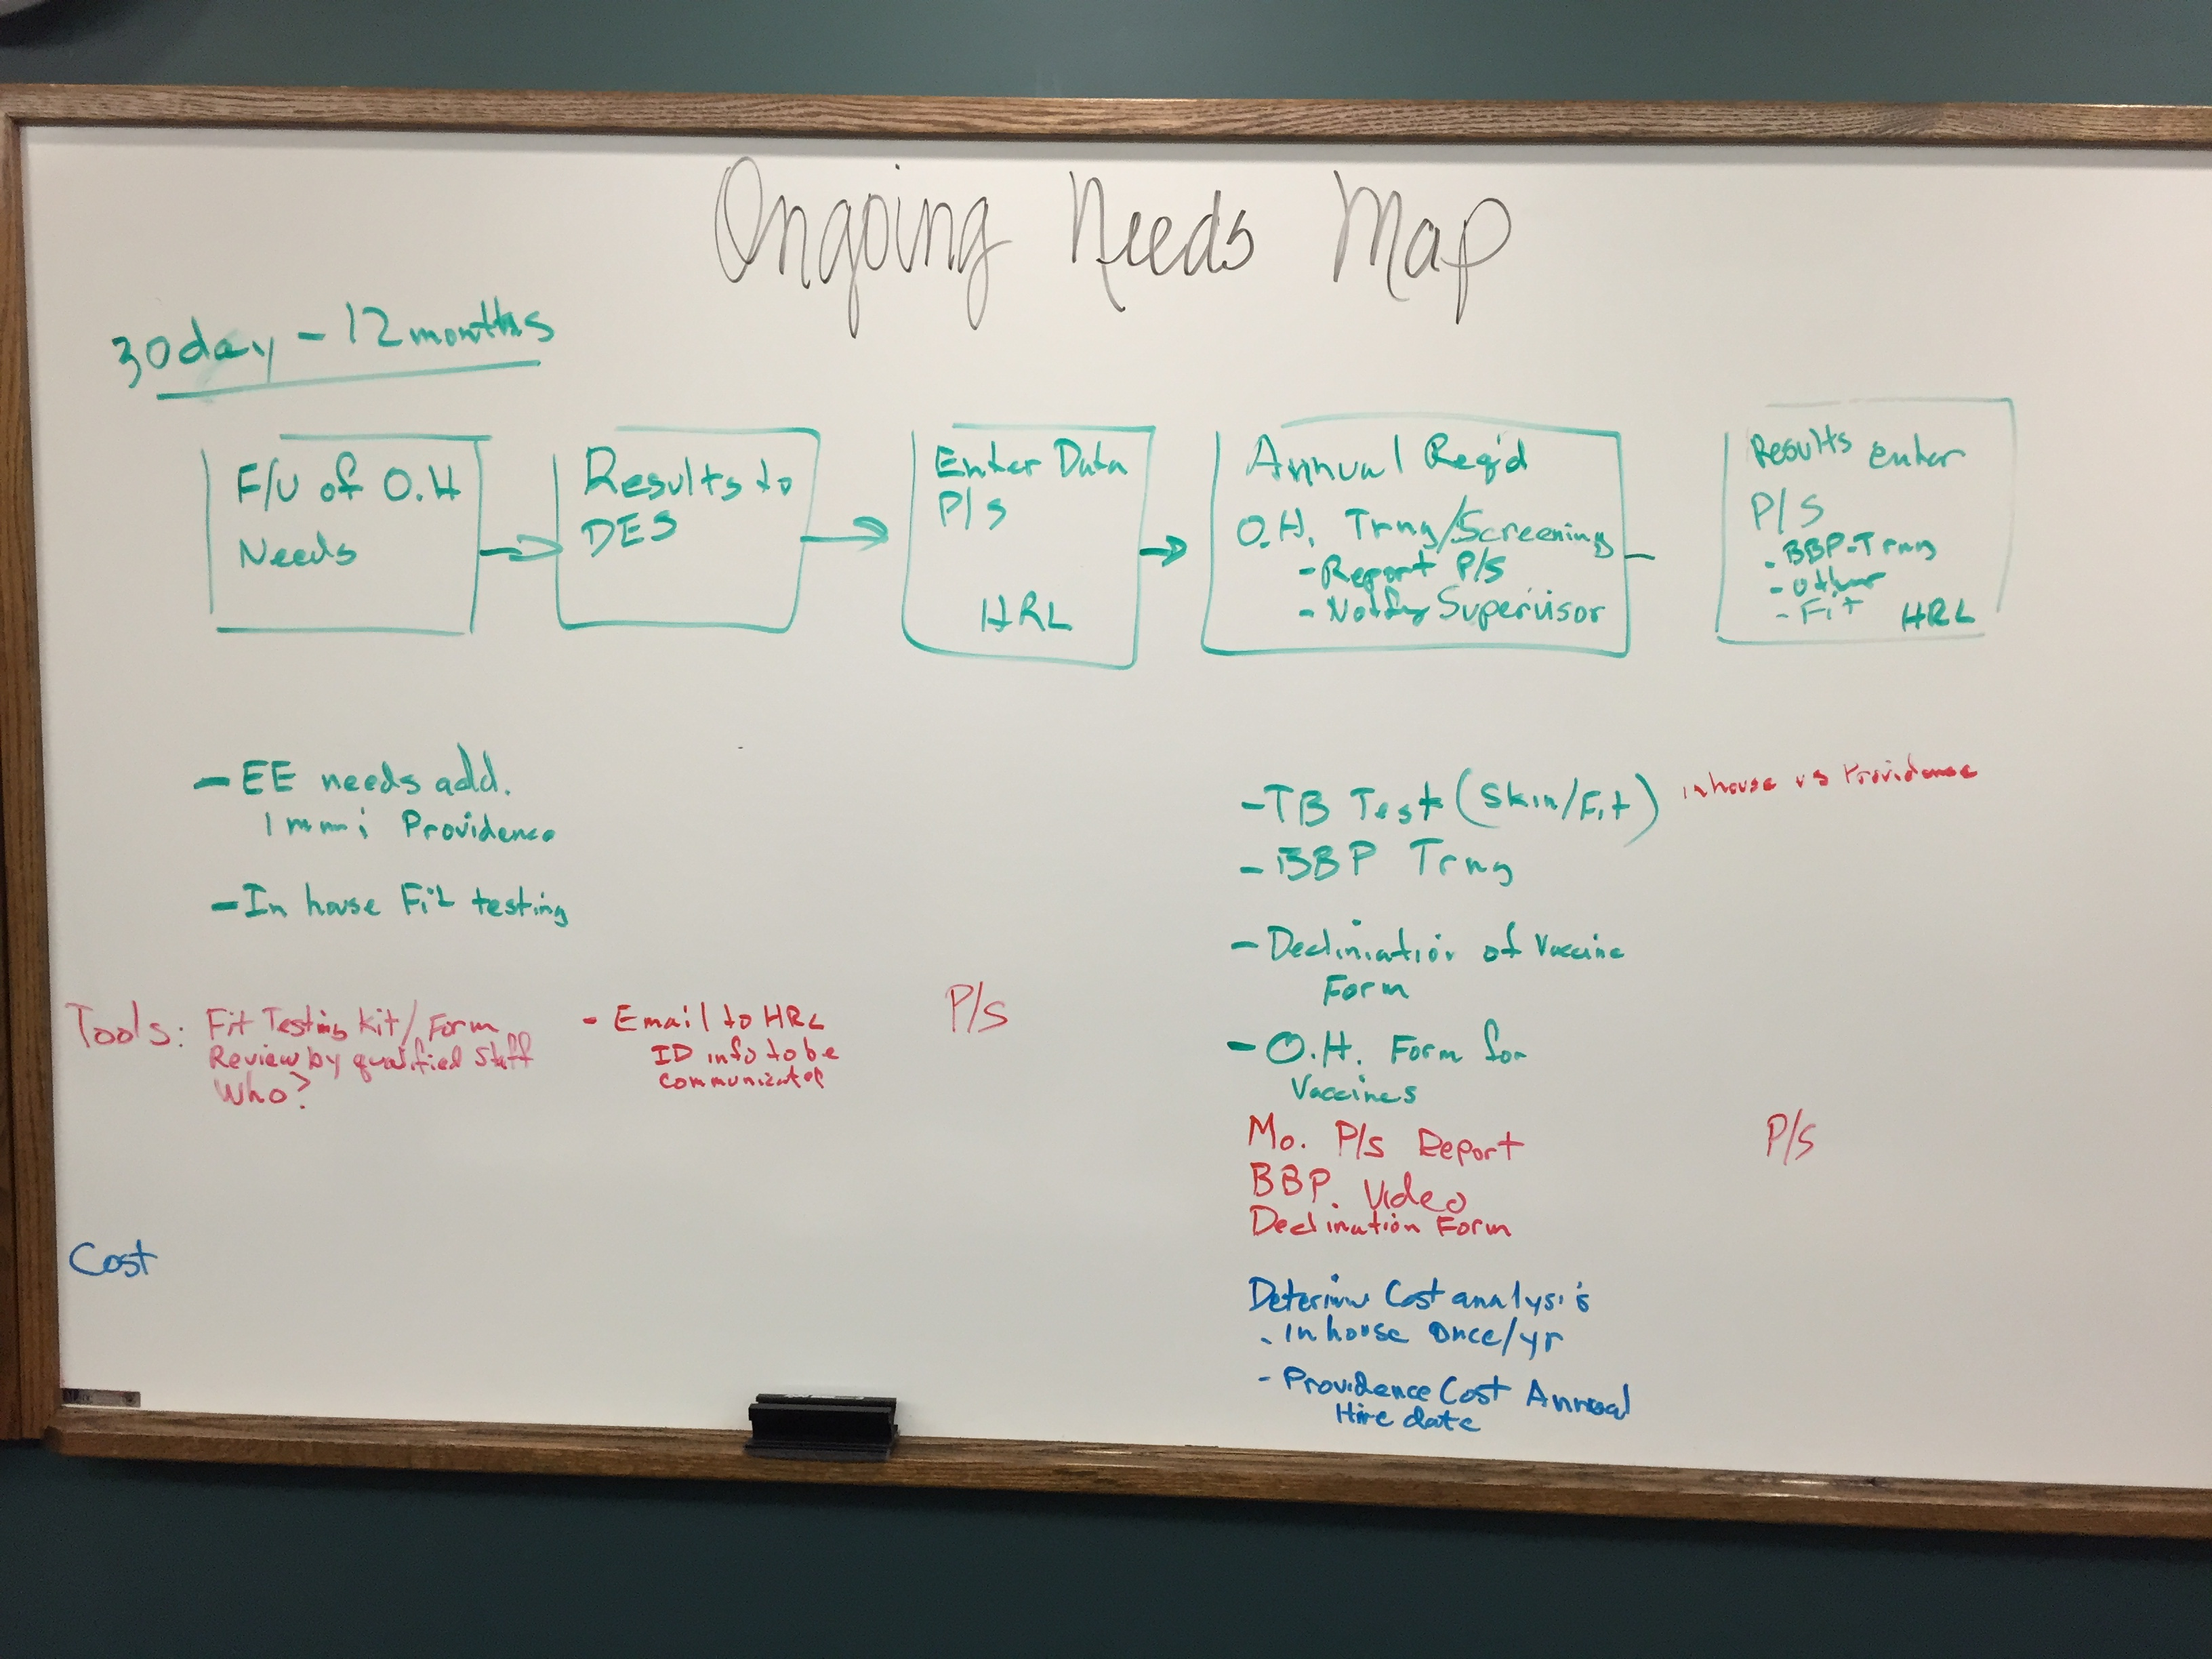
Process Mapping (Erin)

Slide 6
Determining Options (Carolee)
ONBOARDING
Providence |  | In-House
Pros | Cons | Pros | Cons
Confidentiality of staff’s records (x6) Consistent following of the process by trained occupational health nurses (x13) Costs (x8) | Lack of clarity if current contract meets all the needs (x2) Costs (x4) Convenience for new hires (x1) | Accountability (x2) No contract needed (x1) | Staff time (x1) Consistency (x2) Confidentiality (x2) Cost (x7) Equipment (x2)
ONGOING NEEDS
Providence |  | In-House
Pros | Cons | Pros | Cons
Consistency (x8) Confidentiality (x4) | Costs (x1) Time (x1) | Cost (x4) Time (x6) Efficiency (5) | Confidentiality (x1) Inconsistency (x2) Responsibility (x2) In-efficient (x5) Time (x2)

Slide 7
Costs (Sherry)
See excel spreadsheet

Slide 8
Summary of Recommendations (Angie)
Contracting occupational health services through Providence for new hires.
Ongoing needs for employees’ occupational health be provided in-house. This includes annual TB screening & FIT testing, bloodbourne pathogen training/refreshers.
Employees’ occupational health requirements be determined based on exposure type.
Required/Recommended to receive flu, MMR, Tdap and Varicella, or proof of immunity
HR Liaisons will work with Managers and Supervisors to review and update current class specs’ occupational health needs on an annual basis.

Slide 9
Remaining Questions & Concerns (Cathy)
Will we require or suggest new hires have all of the CDC’s recommended immunizations for healthcare workers?
Need to determine who is qualified to make decisions on the occupational health requirements for each position based on:
Classification
Role/job function
Division
Location
DES: Will Providence Occupational Health inform DES when Immunization Reviews (and if any vaccines need to be administered) are completed-- similar to what is currently done for UAs?
DES: Do the unions need to be informed of this new process?

Slide 10
Next Steps / Q&A (Cheryl)
Monday, February 2nd the Lean RPI project team will work to develop the new process based on the feedback received today. This could include:
development of new best methods (flow charts, checklists, desk manuals);
updating policies & procedures;
determining the occupational health requirements for each position used by Health Centers and Public Health Divisions based on classification, role/job function, division & location; and
identifying aspects of the County’s Risk Manual that require updating.
Opportunity for another RPI: Occupational Health & Safety go hand-in-hand. It’s been identified by the team that safety was outside the scope of this project but may need to be another RPI in the near future.

