Slide 1
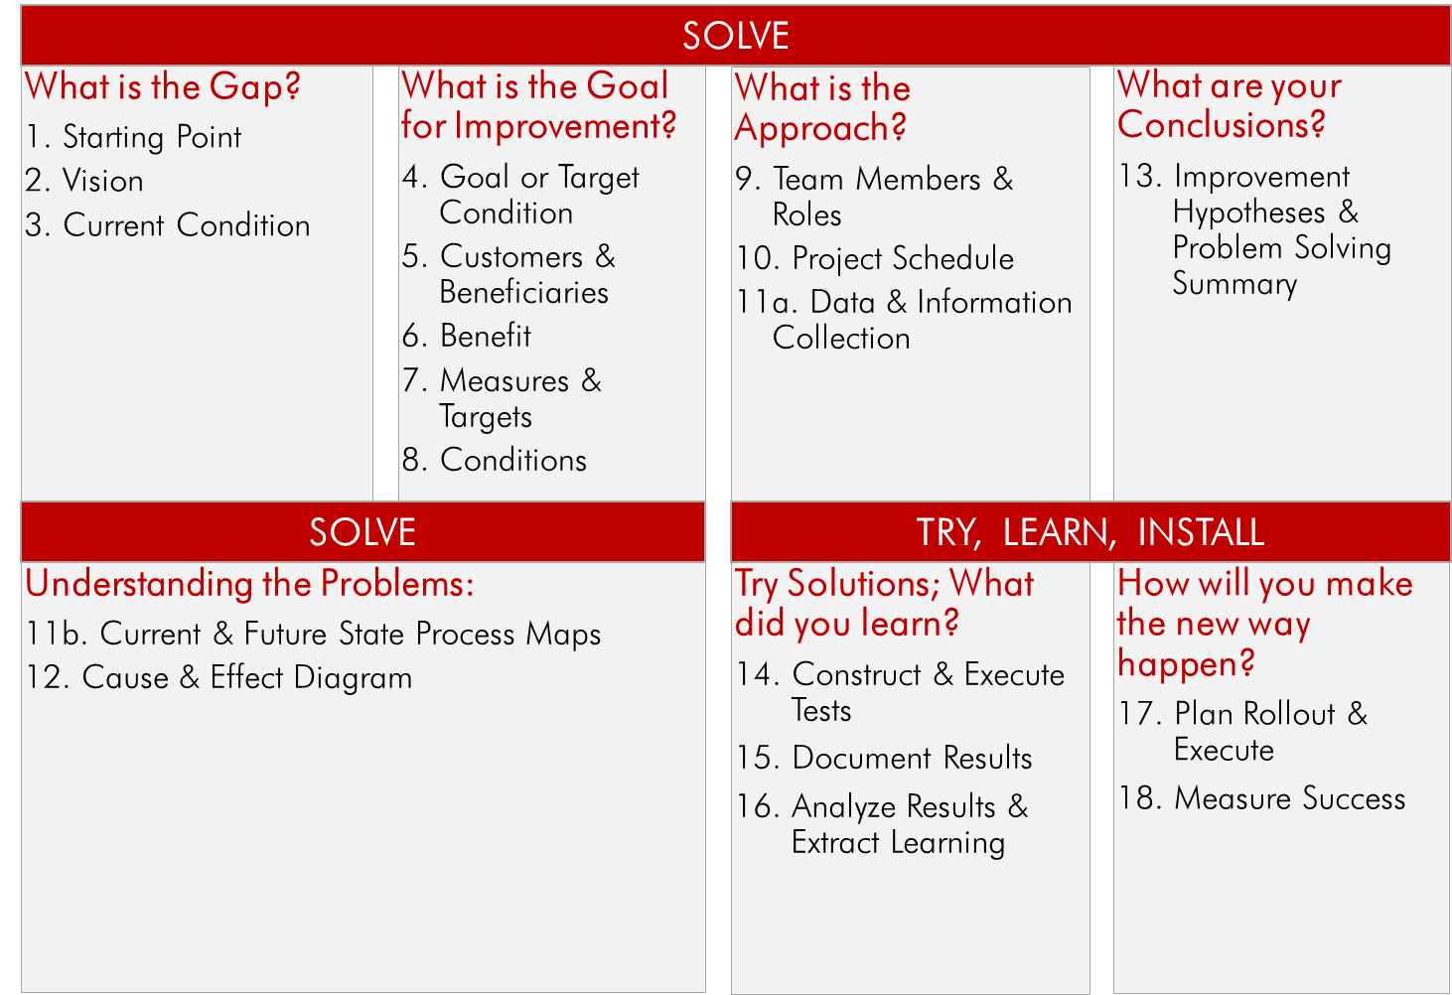

NC State Death Data Registration Process Improvement
1. STARTING POINT
Data is an important part of helping State and Local HDs achieve better health outcomes for their constituencies. Currently there appear to be gaps in the timeliness, accuracy, and usability of data provided to local health departments which hampers effectiveness in its use.
Scope: Start: Local health department registers the death record End: Statewide preliminary data available.
2. VISION LPH has timely and accurate death data to make informed decisions and actions.
3. CURRENT STATE
4. GOAL OR TARGET CONDITION
TO: Improve the availability of timely identifiable death data from a state to local HDs
5. CUSTOMERS AND BENEFICIARIES FOR:
State & Local health departments (EPIs, Program areas, VR & VS teams), NCHS
6. BENEFIT SO THAT:
State and local HDs have data for surveillance, program planning and evaluation, making informed decisions, guiding programs, and ultimately improving health outcomes;
VR & VS tasks are more efficient & require less labor;
State and local employee relationships are improved;
HDs benefit in meeting PHAB standards & accreditation.
7. MEASURES AND TARGETS
8. CONDITIONS
Comply with data collection regulations/statutory
No new IT systems
9. TEAM MEMBERS AND ROLES
13. IMPROVEMENT HYPOTHESIS
Improvement | Expected Results
If we…reduce the batch sizes going through the process: - increase the frequency of mailings from counties based on anticipated volume - make the movement of the certificates throughout the process more visual - modify the office layout to aid in certificate flow | Then…we will improve the speed of certificates going through the process, reduce the labor time required to process and improve the overall visibility of document location and status.
If we…pull the defective certificates offline and into a correction process, then the flow of the non-defective certificates won’t be affected. | Then… we will improve the speed of certificates going through the process, reduce the labor time required to process and improve the overall visibility of documents.
If we…design a more value added process: -Eliminate date received stamp - Only verify fields that are required by NCHS and SSA. - Enter demographic data first - before certificate coding. | Then… we will improve the speed of certificates going through the process and reduce the labor time required to process
If we…consolidate logs | Then…we have less paper to manage, fewer places to search, a reduction in movement, and fewer opportunities for error.
If we…put the file on the SFTP site when data is sent to NCHS. | Then…data is available for those who want it sooner.
10. PROJECT SCHEDULE
DATE | KAIZEN:
1-5-15 | Focus the team. Understand the current process. Complete the current state map.
1-6-15 | Go to the Gemba – observe the process. Prioritize issues by impact and frequency. Complete a root cause analysis.
1-7-15 | Continue root cause analysis. Begin brainstorming solutions. Prioritize solutions by impact and speed & cost.
1-8-15 | Review and discuss waste analysis on sub process map. Continue to develop solutions. Begin testing.
1-9-15 | Test the process, Implement Solutions. Communicate the new process
Customers | - There is a demand from Epidemiologists for more timely and accurate death data. - There is a lack of trust with existing data. - The data is not fully usable in the current format. It needs to be manipulated.
Financial & Team | - Excessive labor hours to prepare and use the data (both state and LPH). - Currently takes NC > 6 months after a death is registered to share the data with LPH.
Number of days from date of death registration to date it is placed on the SFTP server. | From: 120-150 days To: <60 days
Number of days between date of death registration and the date records are submitted to NCHS. | From: 0% of data <= 25 days To: >= 80% of data <= 25 days
% of death certificates numbered per week. | From: ~1634 per week To: 1750 per week
% of counties receiving correction reports per mailing. | Trend
11. DATA & INFORMATION

Slide 2
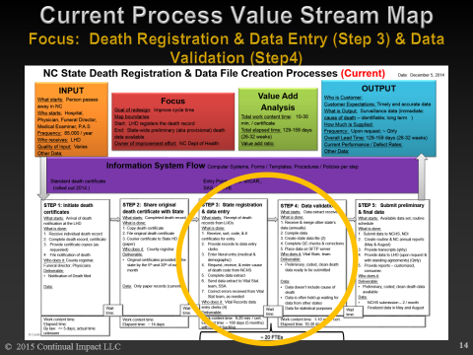
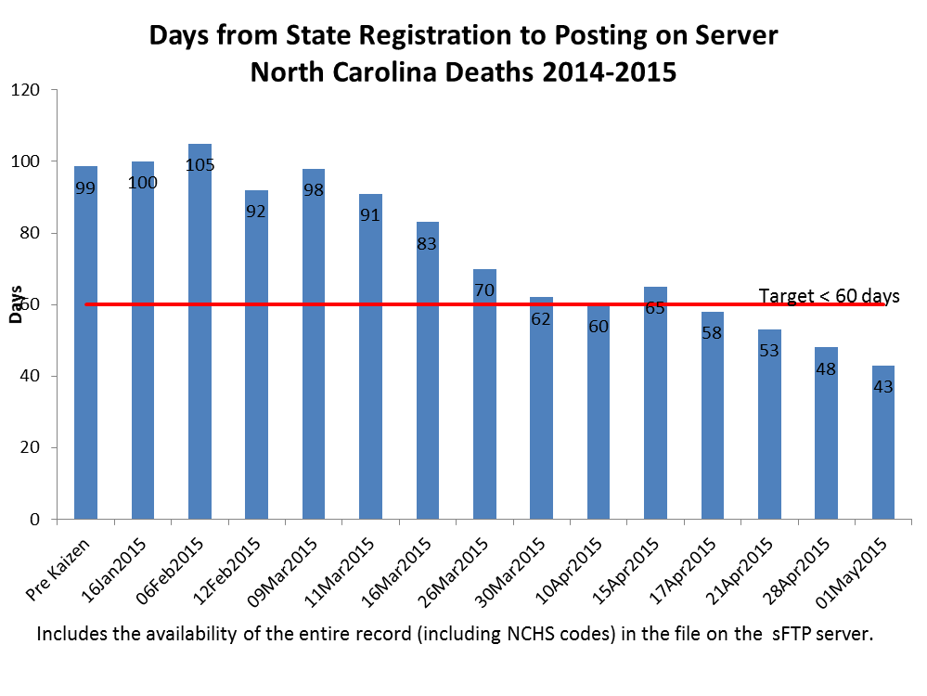
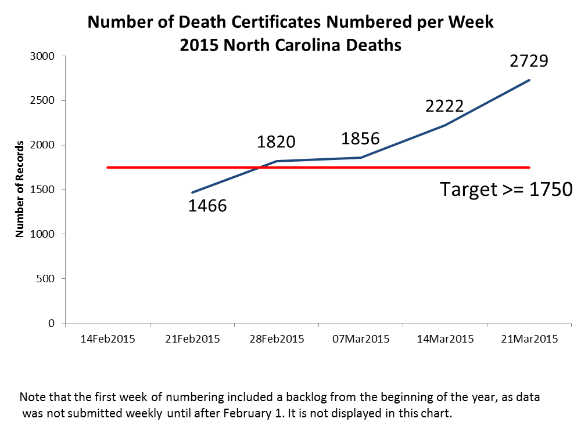
NC State Death Data Registration Process Improvement
11. CURRENT PROCESS
14. TEST PLANS 15. TEST RESULTS
Tests | How | Who | Successful if…
Test run of process using new cover sheet and logs. | Simulated steps mail processing through book in the vault. | Entire team | Customers send in certificates weekly, new cover sheet and logs are used, and batching doesn’t escalate over 100 units.
New cover sheet | Conference walk through by each group | Coding, DE, DV | New coversheet provides staff certificate book mgmt. and leadership the productivity tracking & other logs can be simplified or eliminated.
17. INSTALLATION PLAN
Installation of the new process will incorporate the following improvements:
LHD to mail certificates weekly
Corrections pulled out and given to Corrector (no copies)
No formal Final Arrangement; #ing and data stamping will occur weekly
Batch size is consistent for everyone ~ 100 certificates / batch
Building books of 500 is after registration and data entry is complete
New batch coversheet will be with the batch through the entire process
Streamlined tracking logs
Data Verification will NOT verify every field
Action Plan
See Continual Improvement System for open actions and additional improvement ideas
11. NEW PROCESS
16. LEARNING
Reasons | Learning: Why? | Direction: Actions to be taken
Decrease batch sized will reduce processing time. | Batch reduction reduced delays in waiting for certificates. | Continue to experiment with batches of 100 certificates or less.
 | May still have too much flagging, but not correcting… | Validate flagging benefits with Medical Data Entry
Smooth movement of certificates | To decrease wait times between process activity smooth movement of certificates is needed | Further clarification of handoffs needed. Consider changing the physical layout to decrease wait and movement
18. MEASURE RESULTS
Root Causes:
Batching –County -> 500 -> 500 -> 100 -> 500
Searching for certificates
Stack/pile management
Too many log sheets
Time to rekey in Data Verification
Too many initialing & date stamping each certificate
Too many inspection of each certificate
State receive certificates in varying quantities
12. ROOT CAUSE ANALYSIS

