Slide 1
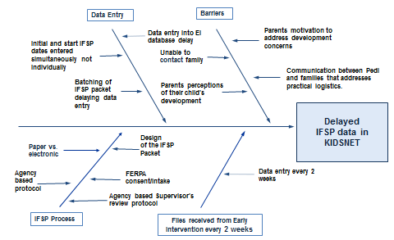
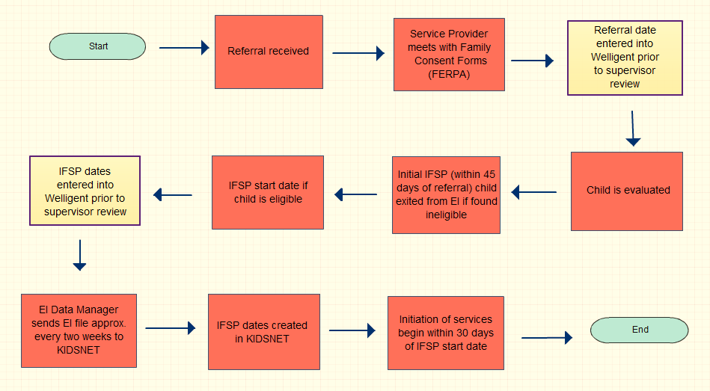
Quality Improvement in Action
Collaborating with Early Intervention (Part C) to analyze
timeliness of Individual Family Service Plan dates (IFSP) entered into KIDSNET
Rhode Island Department of Health & RI Early Intervention (Part C)
Carol Votta, Liza Then,Christine Robin Payne, and Evan Bessette
Domain 1
Conduct and disseminate assessments focused on population health status and public health issues facing the community
PLAN: Find Opportunity for Improvement
AIM Statement (Goal)
STUDY: Analyze Results
Rhode Island Early Intervention (EI) Program promotes the growth and development of infants and toddlers who have developmental disabilities. To determine eligibility, children referred to EI receive a comprehensive developmental evaluation, which could result in the Individual Family Service Plan (IFSP) which needs to be promptly shared with other EI programs, HEALTH (KIDSNET), RIDE, DCYF, RIHAP to ensure care coordination (with parental consent as required).
What is the problem?
Reporting of the (IFSP) date, which triggers services from health care providers, is currently reported to KIDSNET with delays
How do we know this is a problem?
IFSP dates are reported to KIDSNET later than 30 days (timeframe should be <30 days)
Why is this a problem?
Delays in IFSP reporting can delay accessing health care providers and increase likelihood of developmental delays affecting a child’s speech, physical ability, or social skills
Increase the percent of IFSP dates entered in KIDSNET by Early Intervention Agency A within 30 days from 45% to 60% by December 2014.
Agency A Data
DO: Test the ‘Theory for Improvement’
Plan | Review Early Intervention policies and procedures currently in place around data entry of IFSP dates. With the ultimate goal to see an increase in the number of IFSP dates created in KIDSNET within 30 days
Do | Work with EI “Agency A”, to review data entry process into Welligent. Agency A implements change strategy of eliminating the step of “supervisor review” needed for data entry of referral and IFSP dates, for the months of August through December.
Study | Data analysis revealed 56 IFSP dates were entered within 30 days while 32 IFSP dates were entered after 30 days
Root Causes of delayed entry of IFSP dates
ACT: Adapt
Agency A eliminated the supervisor’s review step to speed up the data entry process. With this process change, the IFSP dates entered within 30 days in KIDSNET increased from 45% to 64% in 2014.
Next steps will be to try the change strategy with another EI agency of similar size with IFSP create dates in KIDSNET greater than 30 days.
IFSP data entry process including the implementation of change strategy at Early Intervention Agency A
Moving forward
Add IFSP start date to file transfer
Automate file transfer
Conduct ongoing monitoring of data timeliness to identify possible delays
It takes a team!
Thanks to RI QI Team and all Points-of-Contact
Carol Votta
Liza Then
Ellen Amore
Brenda Duhamel
Christine Robin Payne
Evan Bessette
Richard Lupino
Lessons Learned
Delays in data entry of initial IFSP date were decreased with simple process changes; however, delays may also depend on parent or professional availability
Learning more about the data systems helped staff understand and identify potential problems and solutions
Working with the agencies on this effort opened the dialogue for other possible joint projects
April 2015

